Slide 1
CCMS hands-on: ALAMODE
Ver. 3
Lecturer: Terumasa Tadano (NIMS, Japan)
May 17th, 2019
Download this slide from below: https://github.com/ttadano/alamode/raw/gh-pages/files/

Slide 2
Outline
Overview of ALAMODE software and background theory (< 60 mins.)
Installation of MateriApps LIVE! (~20 mins.) (10 mins. break)
Hands-on session 1: Extraction of harmonic/anharmonic force constants (~ 30 mins.)
Hands-on session 2: Phonons and thermal conductivity (~ 50mins.) (10 mins. break)
Hands-on session 3: Finite-temperature phonons (~60 mins.)

Slide 3
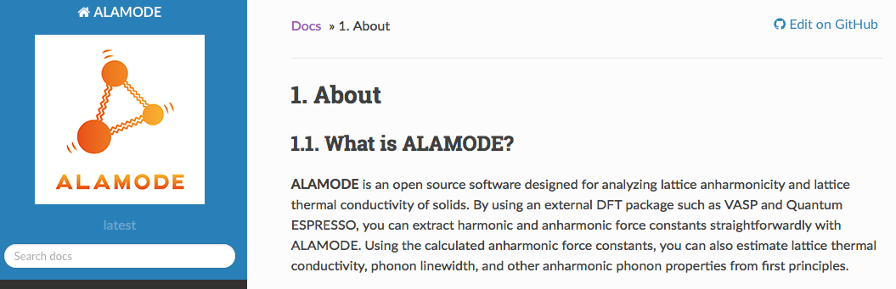
ALAMODE
https://alamode.readthedocs.io/
An open source software to compute anharmonic properties of phonons
MIT license
Latest version: 1.1.0 (Released May 1st, 2019)
Developer: Terumasa Tadano
Contributors (alphabetical order): T. Nishimoto (Ewald method), Y. Oba (Anharmonic free-energy), Y. Tanaka (Interface with OpenMX), A. Togo (Code refactoring, API implementation)

Slide 4
Main features
1. Extraction of harmonic/anharmonic force constants from DFT
Hands-on : 1
K. Esfarjani and H. T. Stokes, Phys. Rev. B 77, 144112 (2008).
T. Tadano, Y. Gohda, and S. Tsuneyuki, JPCM 26, 225402 (2014).
2. Lattice thermal conductivity based on the Peierls-Boltzmann theory
Hands-on : 2
Peierls, “Quantum theory of solids”, Oxford press (1955).
D. A. Broido, A. Ward, and N. Mingo, Phys. Rev. B 72, 14308 (2005).
3. Finite-temperature phonons based on the self-consistent phonon theory
T. Tadano and S. Tsuneyuki, Phys. Rev. B 92, 054301 (2015); J. Phys. Soc. Jpn. 87, 041015 (2018).
Y. Oba, T. Tadano, R. Akashi, and S. Tsuneyuki, Phys. Rev. Materials 3, 033601 (2019).
Hands-on: 3

Slide 5
Requirements
ALAMODE requires an external DFT/FF code that can calculate forces for extracting force constants.
Interface scripts for the following codes are included in tools/ directory: VASP, Quantum-ESPRESSO (QE), OpenMX, xTAPP, and LAMMPS. Also, an interface with GULP is provided by the GULP team.
Required libraries
C++ compiler (Intel compiler is recommended.)
LAPACK library
MPI library
Boost C++ library
FFTW library
Eigen3 library
spglib

Slide 6
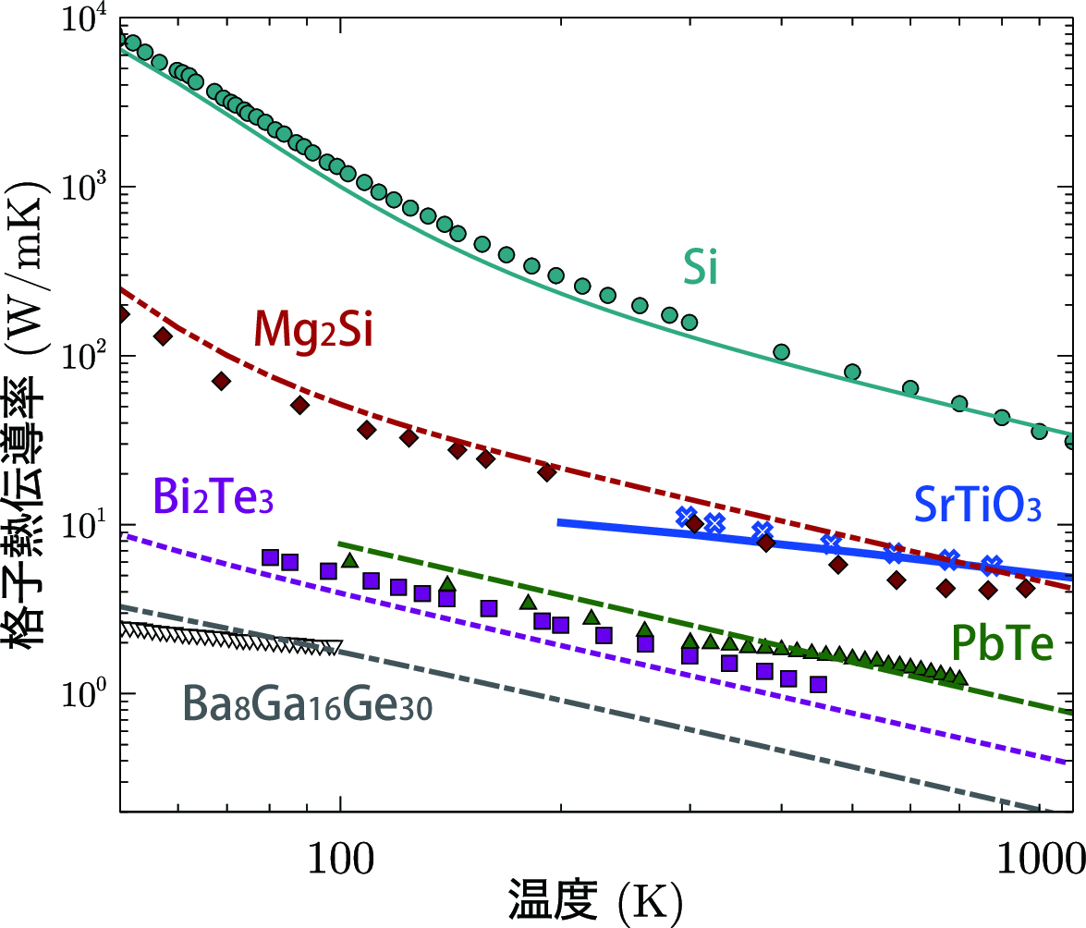
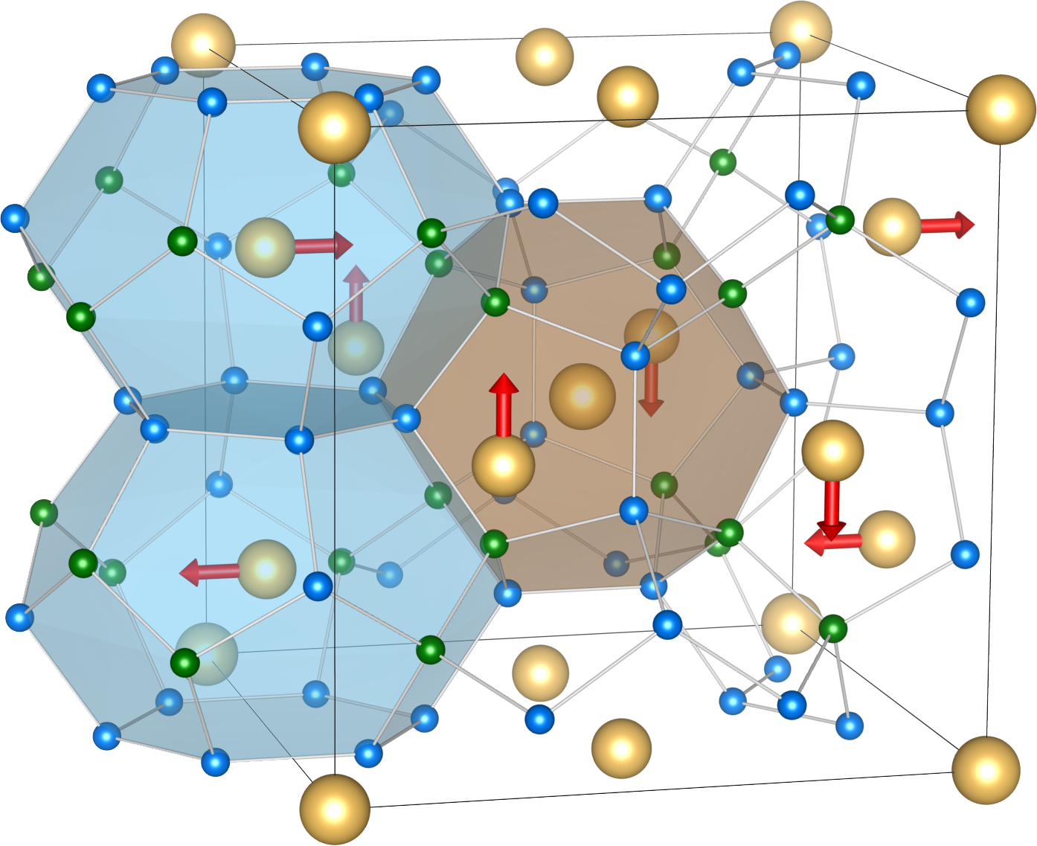
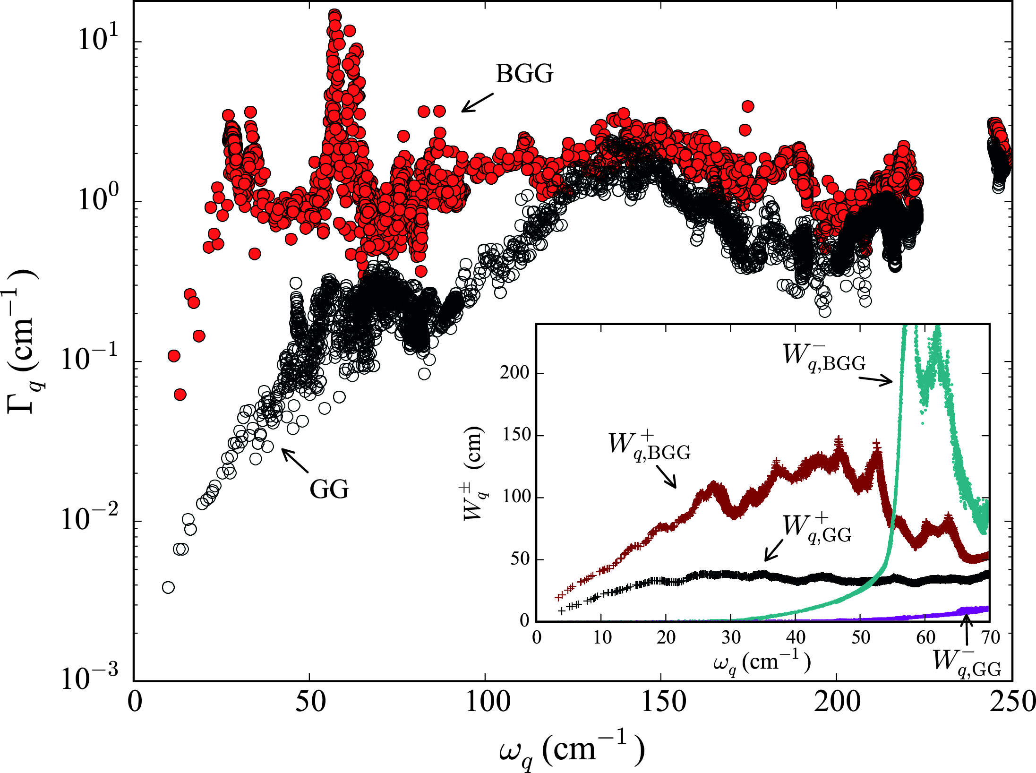
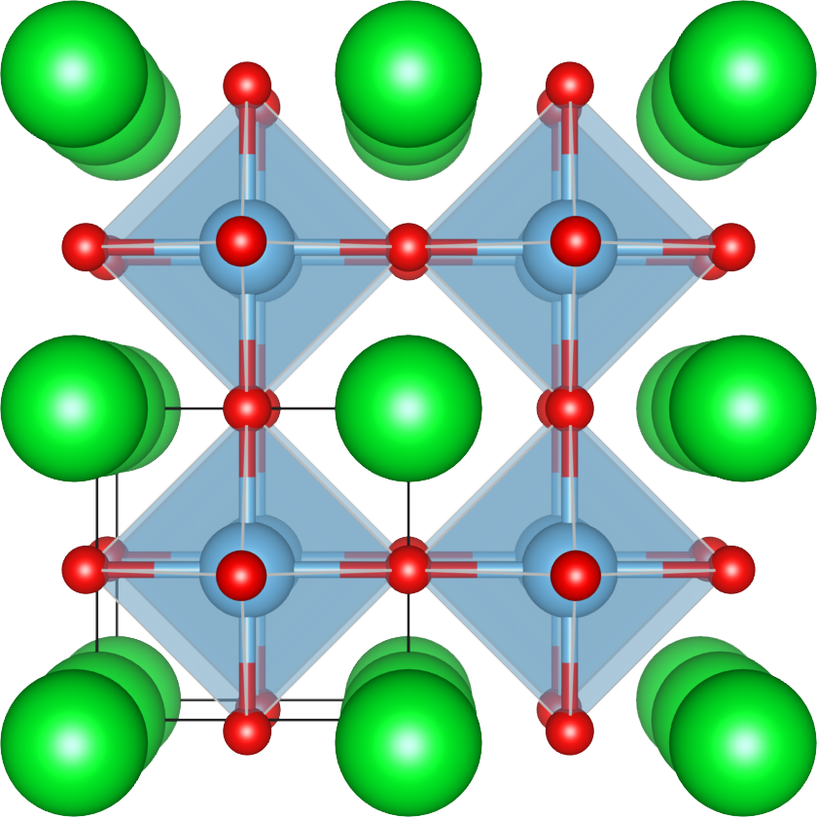
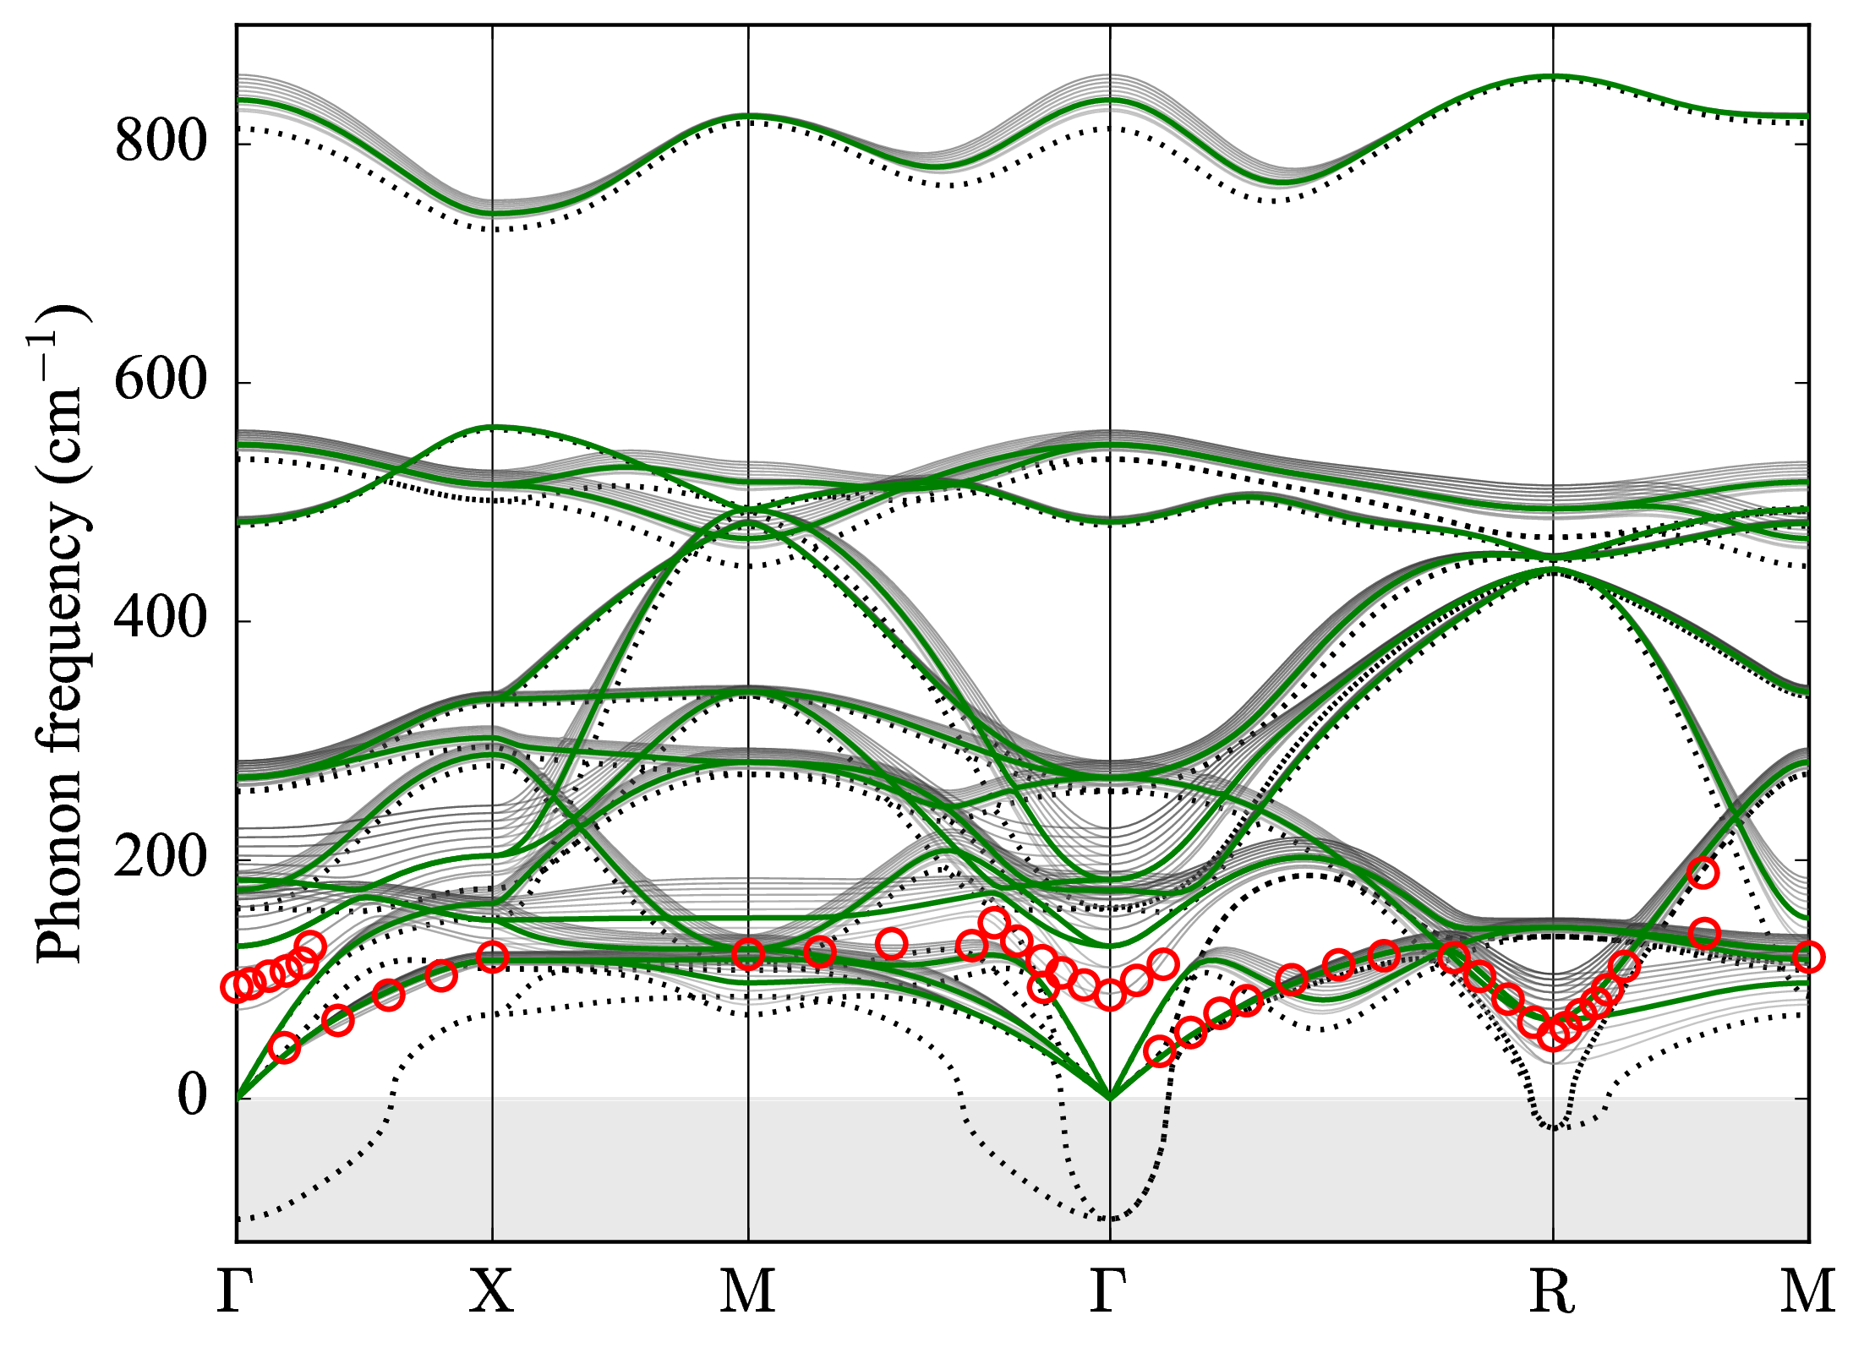
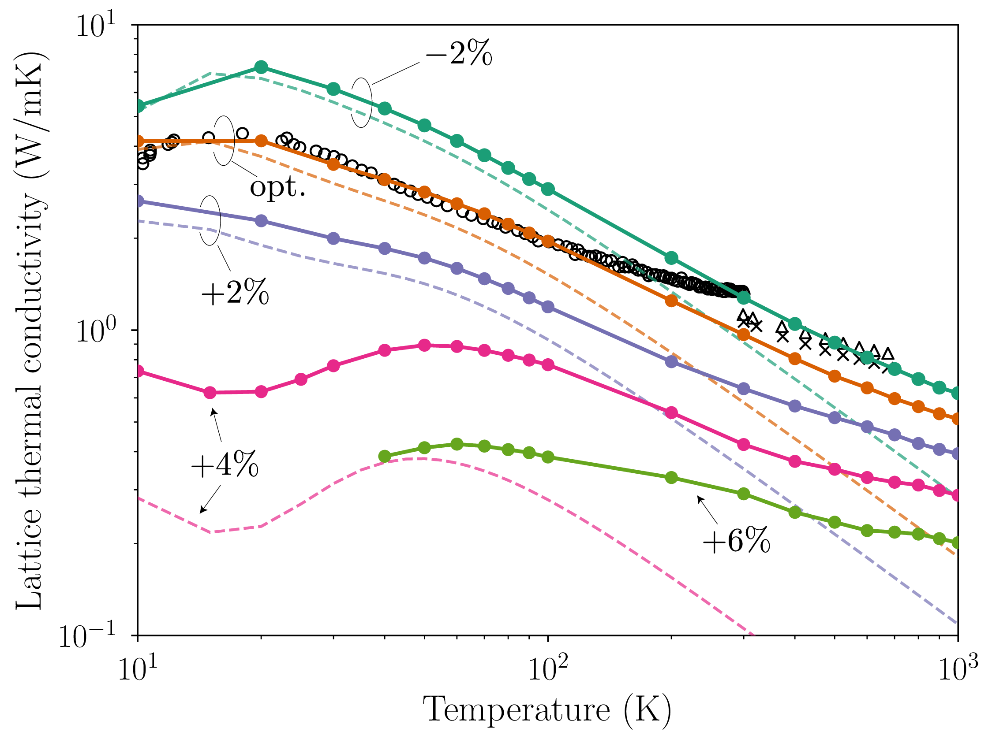
Applications
Ba₈Ga₁₆Ge₃₀
Thermal conductivity of silicon, Mg₂Si, PbTe, Bi₂Te₃, etc.
Thermal conductivity of clathrate Ba₈Ga₁₆Ge₃₀ PRL 114, 095501 (2015); PRL 120, 105902 (2018)
Finite-temperature phonons of cubic SrTiO₃ PRB 92, 054301 (2015); JPSJ 87, 041015 (2018)
Anharmonic free-energy calculation of ScF₃ PRMater 3, 033601(2019).
Lattice thermal conductivity (W/mK)
Temperature (K)
cubic SrTiO₃
More applications can be found at
https://scholar.google.co.jp/scholar?oi=bibs&hl=en&cites=12176096789251895064

Slide 7
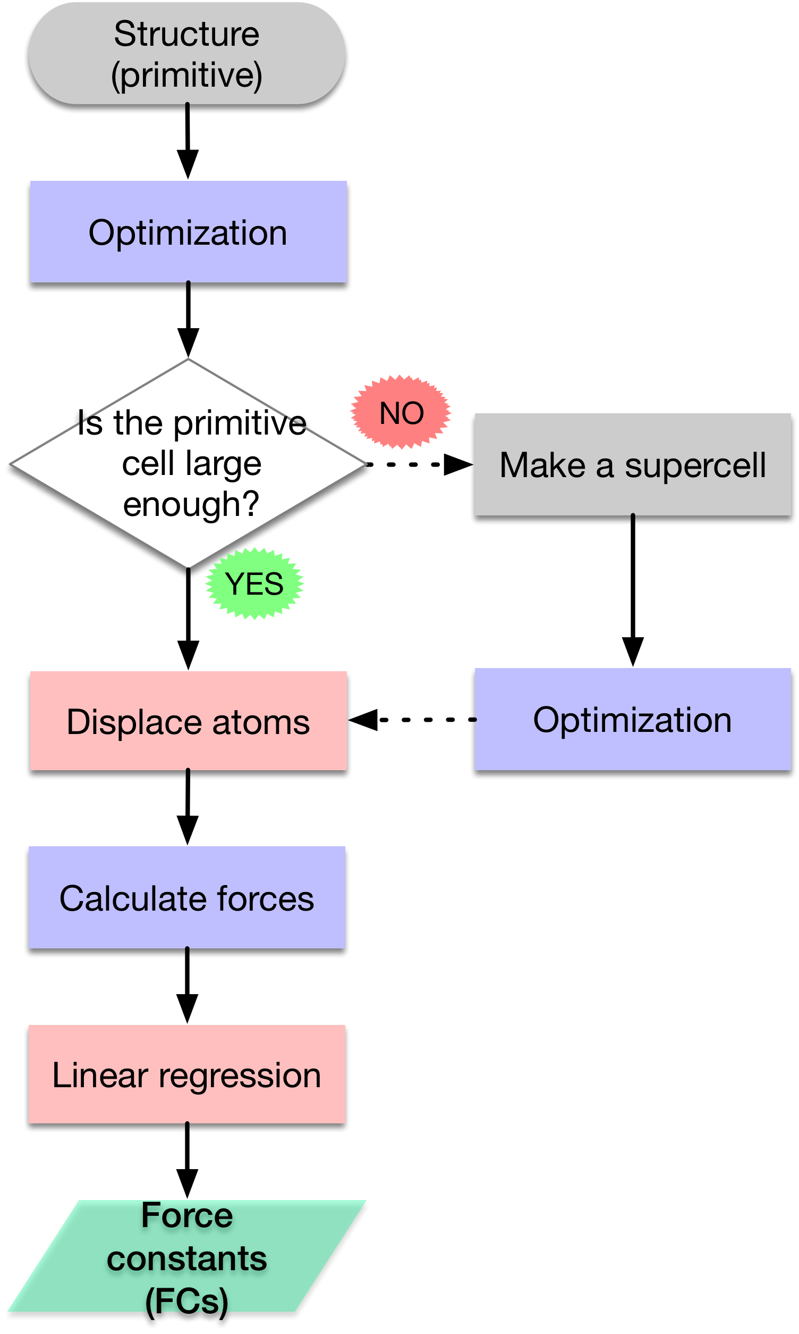
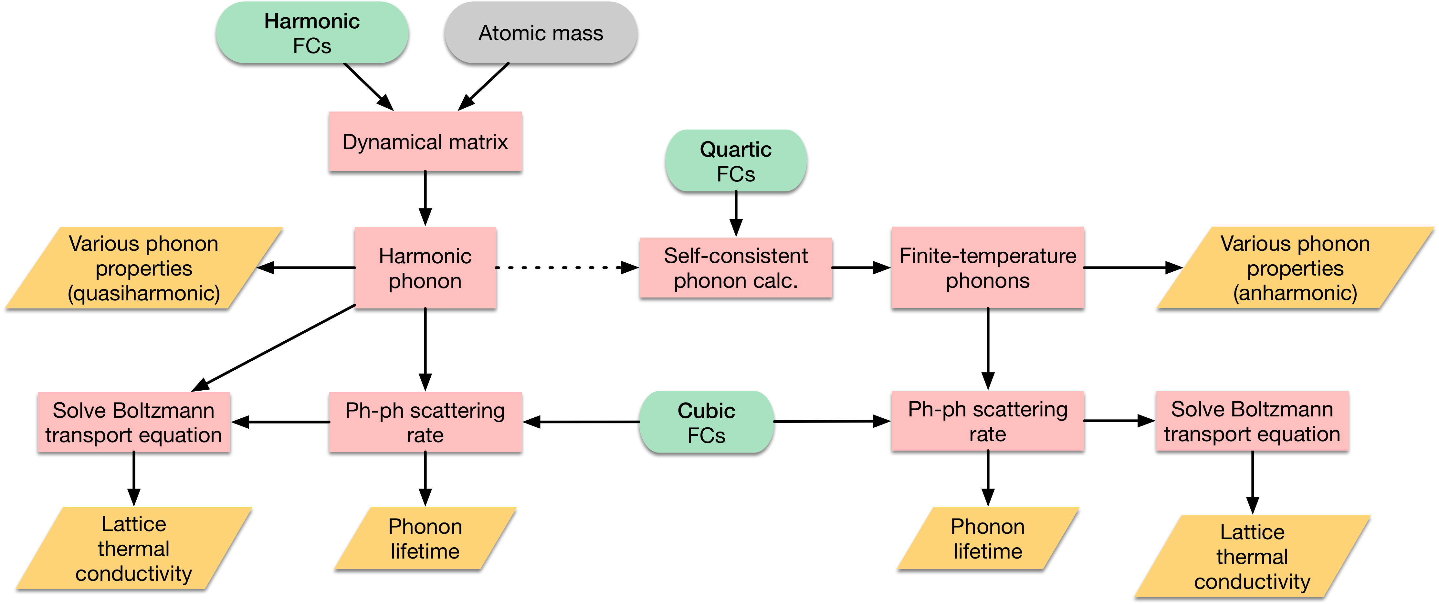
ALAMODE workflow
Blue: DFT/FF code
Red: ALM code
ALAMODE package includes two independent codes: ALM : Force constant calculator, OpenMP
ANPHON: Phonon property calculator, MPI+OpenMP
Red: ANPHON code

Slide 8
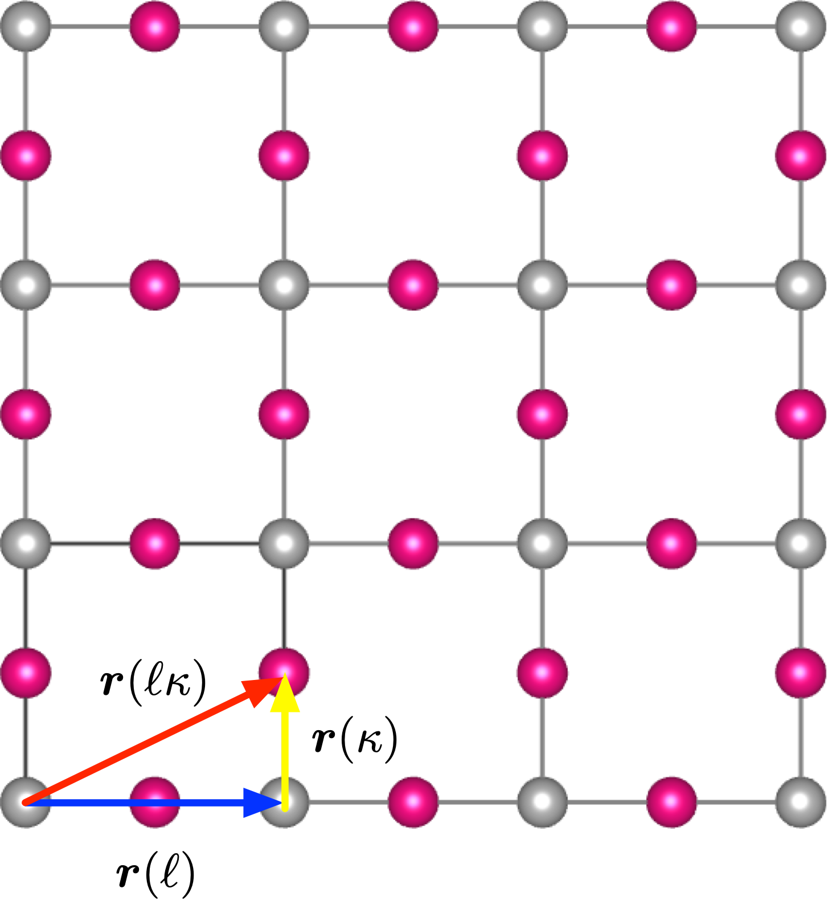
Taylor expansion of potential energy surface
Assumption
Born-Oppenheimer approximation
Potential energy is an analytic function of atomic displacements
Displacements are small enough compared to the interatomic distance
Cell index
Atom index
where is the atomic position optimized by DFT (T = 0 K).

Slide 9
Interatomic force constant (IFC)
th-order IFC is defined as
Second-order (harmonic) term → Lattice dynamics at T = 0 K.
Third-order (cubic) term → Phonon-phonon scattering, thermal expansion, …
Fourth-order (quartic) term → Lattice dynamics at finite temperature, …

Slide 10
Harmonic approximation (HA)
Fourier transform
Dynamical matrix
Normal coordinate
Second quantization

Slide 11
Limitation of HA
Phonon is non-interacting → infinite lifetime→ infinite thermal conductivity
Phonon is volume-independent→ no thermal expansion
Phonon is temperature-independent → no (displacive) structural phase transition
Fails to explain phonons of high-temperature phases

Slide 12
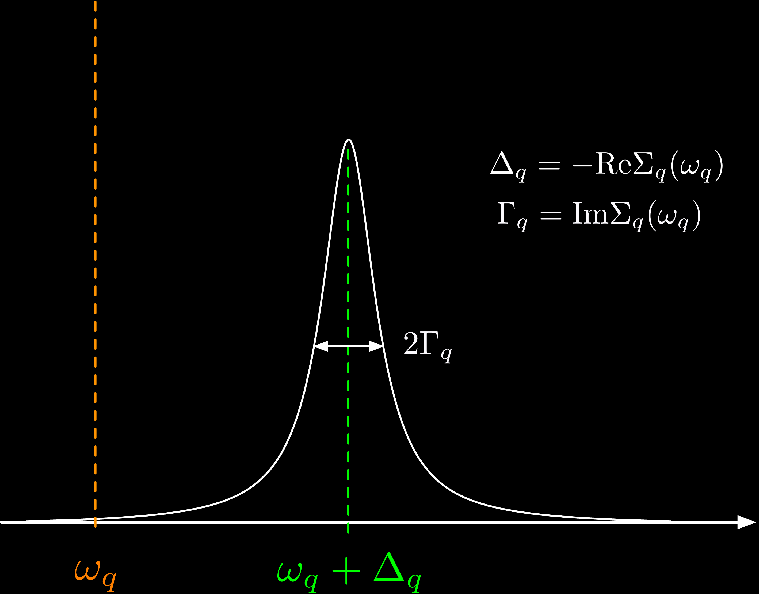
Perturbative treatment of anharmonicity
Non-zero phonon linewidth→ finite lifetime
Phonon frequency shift
A systematic approximation of the phonon self-energy is necessary.

Slide 13
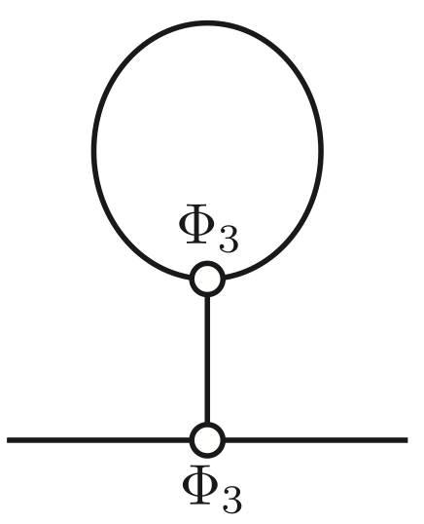
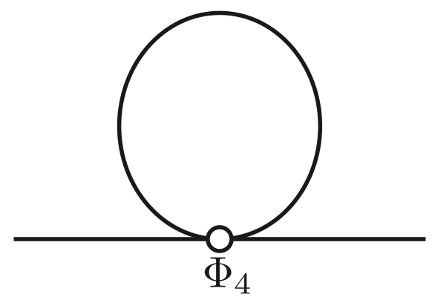
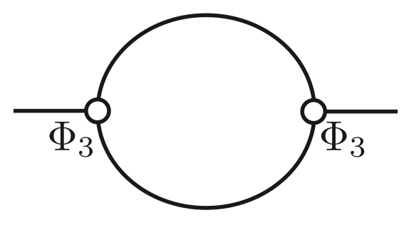
Anharmonic phonon self-energy
Self-energies up to the second order
Tadpole self-energy is non-zero
only for the zone-center (q=0) optical phonons
only when the atomic coordinates can change without breaking the crystal symmetry
Bubble
Tadpole
Loop
Gives frequency shift and linewidth
Give frequency shift only
Loop self-energy is
generally non-zero
included in the self-consistent phonon theory (explained later)
A. A. Maradudin and A. E. Fein, Phys. Rev 128, 2589 (1962).

Slide 14
Bubble self-energy
Bubble
The bubble diagram gives the three-phonon scattering probability

Slide 15

Limitation of the perturbative treatment
The perturbative approach becomes inaccurate when the anharmonicity is strong and even breaks down when the harmonic phonon is unstable ( )
When the phonon frequency is imaginary, we cannot define the non-interacting Hamiltonian:
A nonperturbative approach is desired.

Slide 16
Self-consistent phonon (SCP) theory
N. R. Werthamer, Phys. Rev. B 1, 572 (1970)
Let us assume an effective one-body Hamiltonian exists:
Introduce an operator defined as
Then, the following Gibbs inequality holds:
F: exact anharmonic free-energy
The self-consistent phonon (SCP) frequency is obtained via
SCP theory is the “Hartree-Fock” theory for phonons (mean-field theory)

Slide 17
How to update ρ (effective non-interacting Hamiltonian)?
Stochastic self-consistent harmonic approximation (SSCHA)
Use conjugate gradient method to update ρ and F[ρ] by repeatedly calculating atomic forces in supercells.
The gradient of F[ρ] is calculated stochastically.
Full anharmonicity included
Self-consistent phonon approach based on force constants (SCP)
Compute δF[ρ]/δρ = 0 analytically and derive the self-consistent equation by truncating the higher-order anharmonic terms.
Efficient calculation of ρ and F[ρ] at various temperature
Higher-order terms (sixth, eight, …) are neglected.
Implemented in ALAMODE
I. Errea et al., PRB 89, 064302 (2014).
TT and S. Tsuneyuki, PRB 92, 054301 (2015).

Slide 18
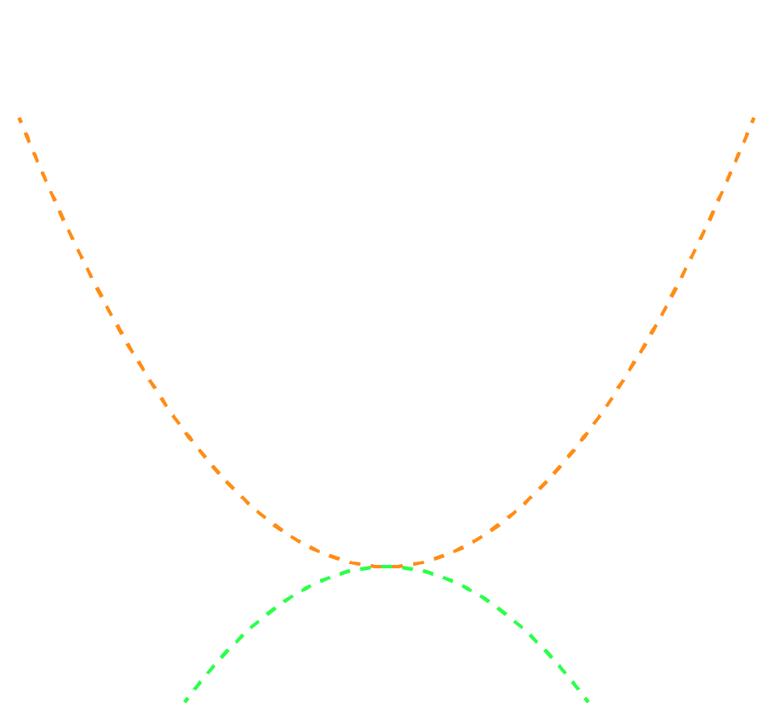
An intuitive view of SCP calculation
Effective 2nd -order IFC
MSD (T-dependent)
Bare 2nd-order IFC
Diagrammatically, the SCP propagator include an infinite set of Feynman diagrams that can be generated from the loop diagram:

Slide 19
Boltzmann transport theory (BTE)
Semiclassical approach to simulate energy transport of quasi-particles. For phonon transport it is given as
Linearization
Elastic scattering (impurity)
three-phonon scattering
Once the phonon frequencies, group velocities, polarization vectors, and the scattering probabilities are given, the above linearized-BTE can be solved iteratively or directly.

Slide 20
Lattice thermal conductivity
Fourier’s law
Phonon gas model
Finally, we obtain the lattice thermal conductivity
In ALAMODE, the single-mode relaxation-time approximation (RTA) is used:

Slide 21
First-principles calculation of IFCs
Method | DFPT [1,2] (density functional perturbation theory) | Direct method [3]
Pros. | Efficient calculation of phonons at q≠0 with a primitive cell Able to compute dielectric constants, Born effective charges | Easy to implement Able to compute fourth- and higher-order IFCs Meta-GGA, vdW functional, and hybrid functional can be used
Cons. | Difficult to implement (Currently) up to cubic IFCs Beyond LDA (hybrid functional, etc.) calculation is not supported in available softwares | Need a supercell to calculate phonons at q≠0
Software | Quantum ESPRESSO Abinit VASP (only q=0) | Phonopy PHONON ALAMODE ...
[1] P. Giannozzi et al., PRB 43, 7231 (1991). [2] X. Gonze, PRB 55, 10337 (1997).
[3] K. Parlinski, Z. Q. Li, and Y. Kawazoe, PRL 78, 4063 (1997).

Slide 22
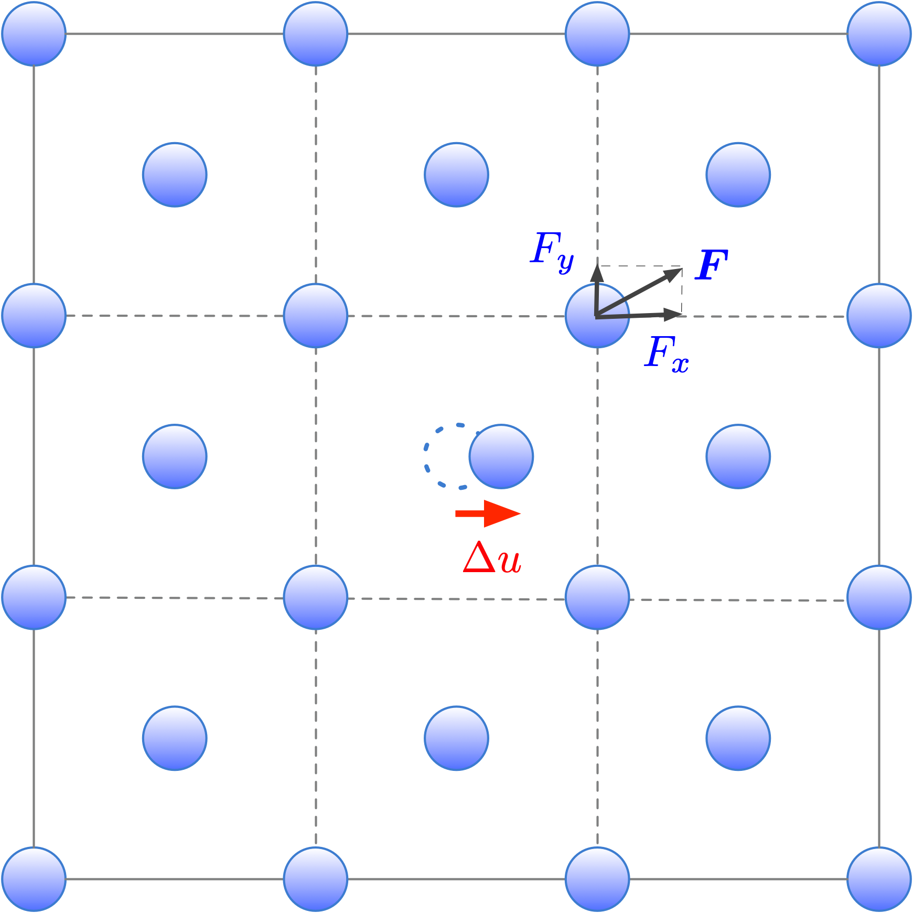
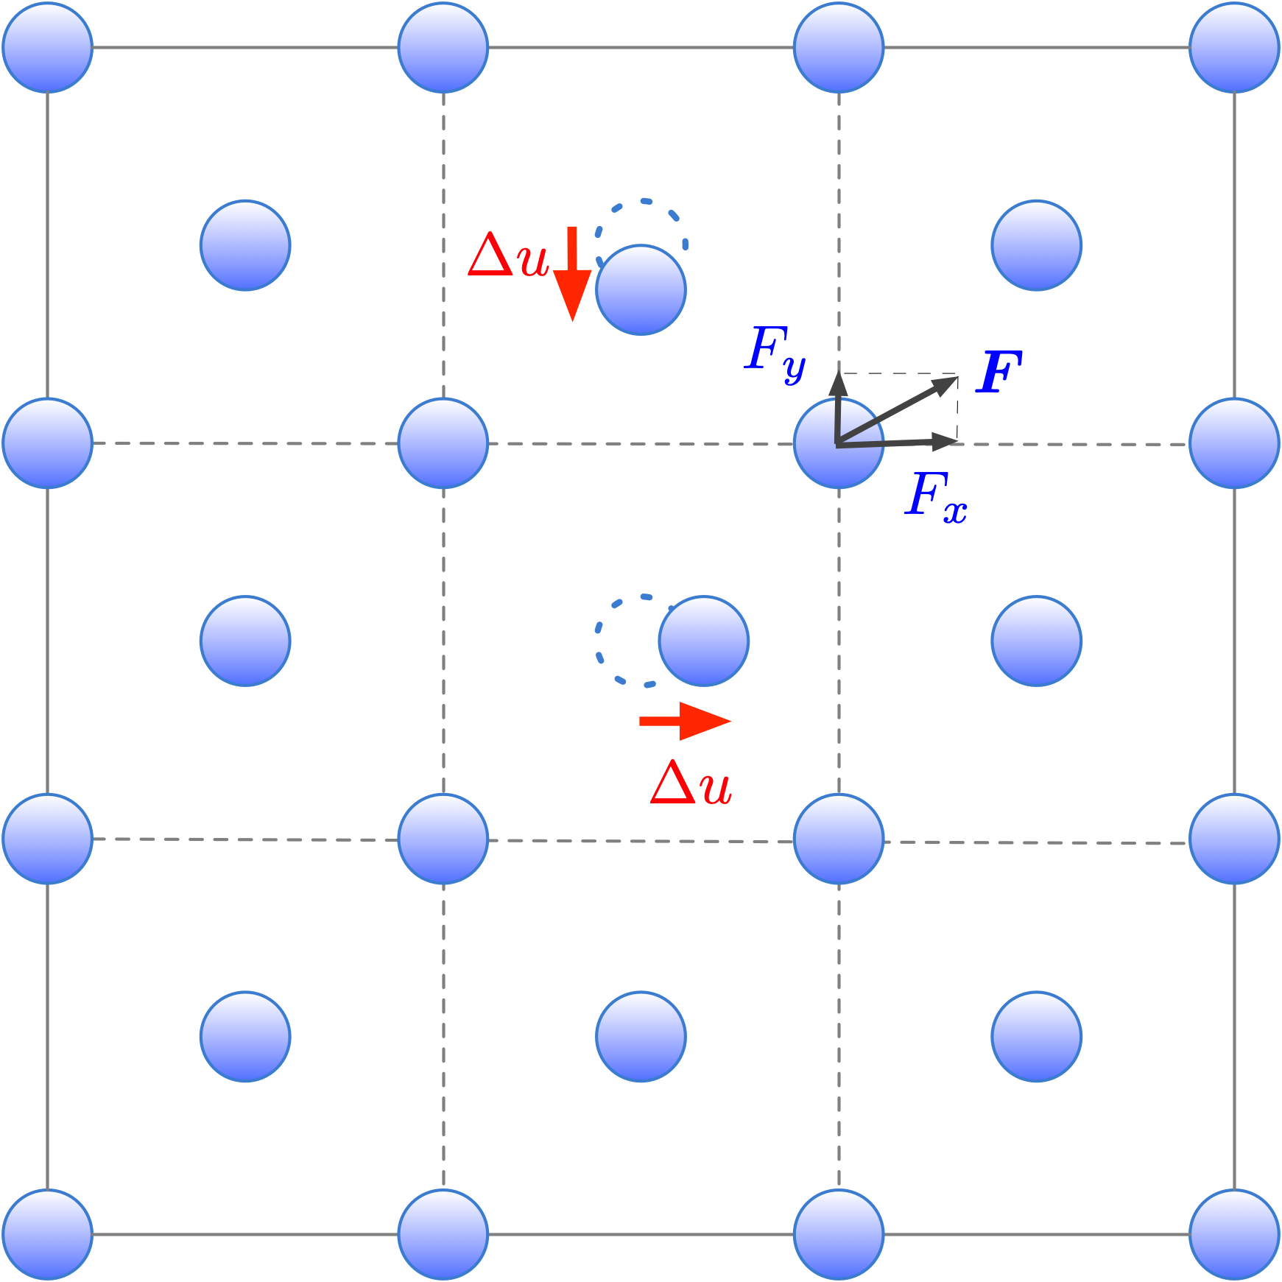
Direct method (finite difference)
Harmonic IFCs
Cubic IFCs

Slide 23
Direct method (linear regression)
Taylor expansion (Anharmonic lattice model: ALM)
N: The number of independent IFCs
Forces in ALM
The number of atoms in the supercell

Slide 24
Direct method (linear regression)
Ordinary least-squares (OLS)
:Sensing matrix where
:Vector comprising M force components
To determine all components of uniquely, must be a full-rank matrix.
Necessary displacement patterns can be generated systematically based on symmetry arguments or molecular dynamics simulations (TT, JPCM 26, 225402 (2014)).

Slide 25
Symmetry relationships between IFCs
Permutation
Periodicity
Space group symmetry
These symmetry relationships are fully utilized in ALM to reduce the number of independent IFCs.

Slide 26
Constraints between IFCs
Translational invariance (a.k.a acoustic sum rule: ASR)
The ASR must be satisfied accurately. If the deviation from the ASR is large, the resulting phonon dispersion curves and/or lattice thermal conductivity values are unreliable.
OLS with equality constraint
subject to
The matrix can be large when higher-order and long-distance anharmonic terms are included in ALM. We need a lot of RAM to solve the OLS problem directly.

Slide 27
Dynamical matrix
Exact dynamical matrix in an infinite-size crystal
Dynamical matrix constructed from IFCs inside a supercell
The dynamical matrix becomes exact, i.e. , when is satisfied for all L_{s}. The momentum q satisfying this condition is called commensurate q point.

Slide 28
Non-analytic (NA) correction
In insulators (semiconductors), the ion-ion Coulomb interaction is long-range
Parlinski’s approach (K. Parlinski, Z. Q. Li, and Y. Kawazoe, PRL 81, 3298 (1998))
Mixed-space approach (Y. Wang et al., JPCM 22, 202201 (2010))
Ewald summation method (X. Gonze and C. Lee, PRB 55, 66389 (1997))

Slide 29
Installation of ALAMODE
Necessary environment:
RAM: > 4 GB CPU: Single core is sufficient, but multicore is preferable.
MateriApps LIVE! version (use version 2.3 or newer):
> ﻿export PYTHONPATH=/usr/share/alamode/tools/
Manually installed version:
> ﻿export PYTHONPATH=/path/to/alamode_root/tools/
> export LD_LIBRARY_PATH=/path/to/spglib/lib:$LD_LIBRARY_PATH
Copy the ALAMODE binaries (alm, anphon) to a directory included in PATH (or use the absolute path to these binaries).

Slide 30
Download
Please download the input files for the hands-on session from https://github.com/ttadano/alamode/raw/gh-pages/files/ALAMODE_handson.tar.bz2
> wget https://github.com/ttadano/alamode/raw/gh-pages/files/ALAMODE_handson.tar.bz2
> tar xvjf ALAMODE_handson.tar.bz2
> cd ALAMODE_handson
> tree -L 2
.
├── 01_force_constant_silicon
│ ├── data # contains DFT results
│ ├── ref # input/output files ← Refer to files here in case of problem
│ └── work # work directory
├── 02_thermal_conductivity_silicon
│ ├── ref
│ └── work
├── 03_self_consistent_phonon_STO
│ ├── data
│ ├── ref
│ └── work
└── html # contains documentation html (index.html)
# same as alamode.readthedocs.io

Slide 31
Hands-on: part 1
Topics
Calculation of harmonic/anharmonic IFCs of bulk silicon
Details
Use VASP for explanation
a = 5.403 Å
PBEsol xc functional
> cd 01_force_constant_silicon/work/
> vesta primitive.POSCAR.vasp

Slide 32
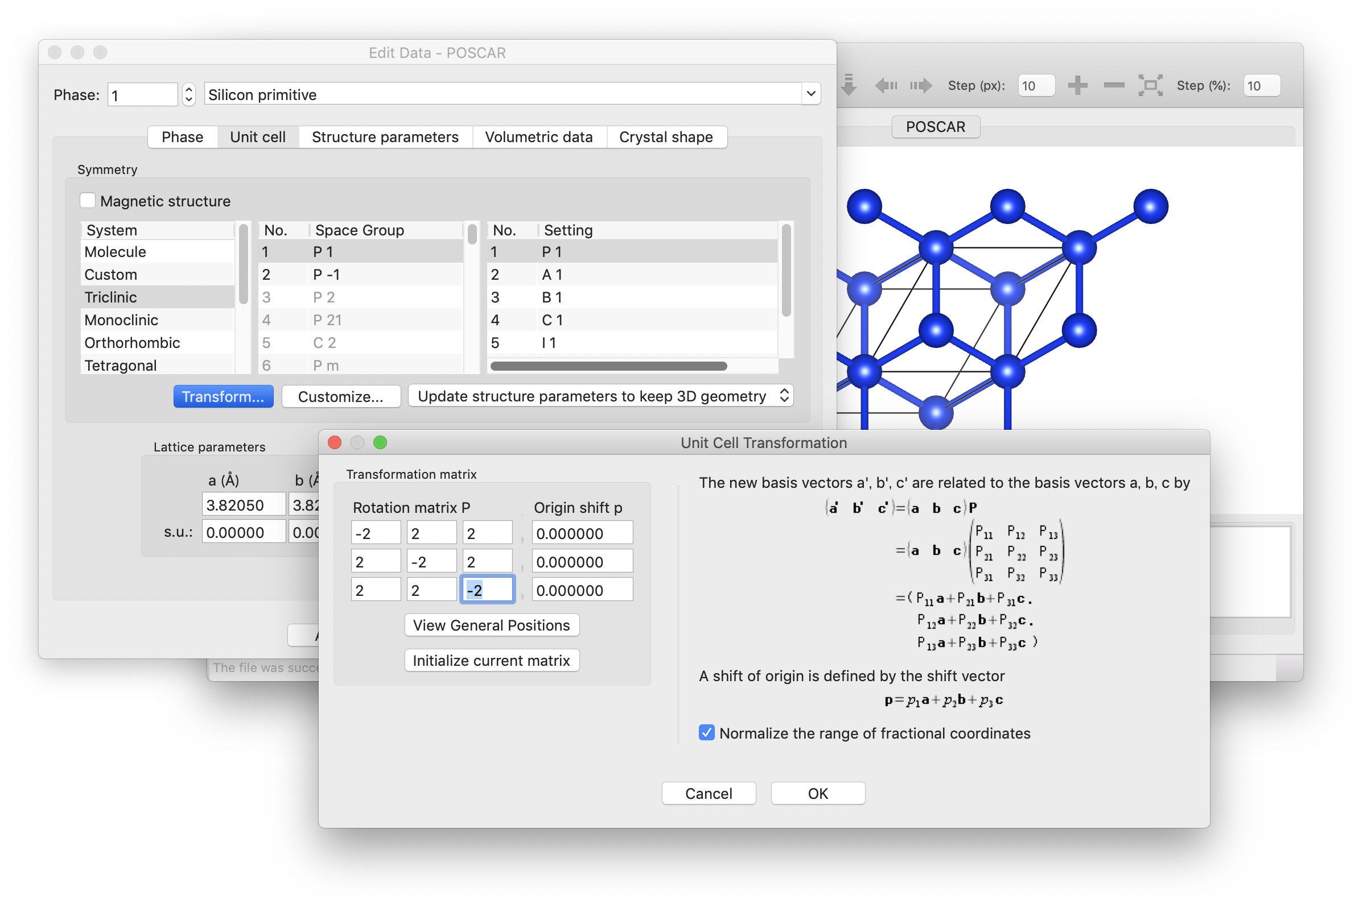
1.1 Create a supercell
Currently (ver. 1.1.0), creation of a supercell structure is not supported by ALAMODE. So please create the structure by using any of the following approaches:
Use VESTA
Use pymatgen.Structure.make_supercell method
Write a simple script by yourself
In VESTA: Edit → Edit data → Unit cell → Transform
Rotation matrix P:
−2 2 2
2 −2 2
2 2 −2
Fil e→ Export Data → File type VASP → Save as “si222.POSCAR”
NOTE: Automatic generation of supercell structure will be supported in a future version of ALAMODE.

Slide 33
1.2 Create an ALM input and run ALM
File: ALM0.in
terminal
&general
PREFIX = si222
MODE = suggest
NAT = 64; NKD = 1
KD = Si
/
# Define the Taylor
# expansion potential
&interaction
NORDER = 1 # harmonic
/
&cutoff
Si-Si None
/
# Supercell structure
&cell
20.42 # in Bohr unit
1.0 0.0 0.0
0.0 1.0 0.0
0.0 0.0 1.0
/
# Fractional coordinates # of 64 atoms, which must
# be exactly the same as
# si222.POSCAR.vasp
&position
1 0.0000 0.0000 0.0000
1 0.2500 0.2500 0.0000
...
1 0.6250 0.1250 0.1250
/
> alm ALM0.in > ALM0.log
> grep "Space group" ALM0.log
Space group: Fd-3m (227)
> grep "Number of disp. patterns" ALM0.log
Number of disp. patterns for HARMONIC : 1
Tips:
Space group symmetry is very important. Please check if the detected symmetry is correct.
Recommended to use 15 decimal digits for the &cell and &position field. (e.g. √3/2 should be ﻿0.86602540378443, not 0.866025.)

Slide 34
1.3 Generate displaced structures
> python -m displace --VASP si222.POSCAR.vasp --mag 0.01 --prefix harm si222.pattern_HARMONIC
> less harm1.POSCAR
Disp. Num. 1 ( 0.010000 Angstrom, 1 : +x)
1.0
10.805999755900000 0.000000000000000 0.000000000000000
0.000000000000000 10.805999755900000 0.000000000000000
0.000000000000000 0.000000000000000 10.805999755900000
Si
64
Direct
0.000925411829159 0.000000000000000 0.000000000000000
0.250000000000000 0.250000000000000 0.000000000000000
...
Tips:
Set the magnitude of displacements small enough to exclude anharmonic effects in the calculated atomic forces. Typical value of --mag is 0.01–0.04.

Slide 35
1.4 Anharmonic force constants
File: ALM0.in
# Up to cubic IFCs
&interaction
NORDER = 2
/
&cutoff
Si-Si None 7.3
/
← (Edit ALM0.in and run ALM again)
> python -m displace --VASP si222.POSCAR.vasp --mag 0.04 --prefix cubic si222.pattern_ANHARM3
> python -m displace --VASP si222.POSCAR.vasp --mag 0.08 --prefix quartic si222.pattern_ANHARM4
A triplet cluster is included in the model when all of the pair distances are smaller than the cutoff radius. The same rule applies to fourth- and higher-order
# Up to quartic IFCs
&interaction
NORDER = 3
NBODY = 2 3 3
/
&cutoff
Si-Si None 7.3 7.3
/
NBODY-tag is useful to reduce the number of anharmonic (>3) IFCs.
https://alamode.readthedocs.io/en/latest/almdir/inputalm.html#alm-nbody

Slide 36
1.5 Calculate forces with a DFT/FF code
File: run_vasp.sh
#!/bin/bash
# harmonic
cp harm1.POSCAR POSCAR
exec vasp
mv OUTCAR harm1.OUTCAR
mv vasprun.xml vasprun_harm1.xml
# cubic
for ((i=1;i<=16;i++))
do
num=`echo $i | awk '{printf("%02d",$1)}’`
cp cubic${num}.POSCAR POSCAR
exec vasp
mv OUTCAR cubic${num}.OUTCAR
mv vasprun.xml vasprun_cubic${num}.xml
done
Tips:
Calculation of forces for the displaced configurations is one of the most expensive part of the procedure
This part can be run in parallel

Slide 37
1.6 Parse displacement-force datasets
> python -m extract --VASP si222.POSCAR.vasp vasprun_harm1.xml > DFSET_harmonic
> python -m extract --VASP si222.POSCAR.vasp vasprun_cubic*.xml > DFSET_cubic > less DFSET_harmonic
# Filename: vasprun_harm1.xml, Snapshot: 1, E_pot (eV): -381.36281443
0.0188972 0.0000000 0.0000000 -5.21238925E-03 0.00000000E+00 -0.00000000E+00
0.0000000 0.0000000 0.0000000 7.49413696E-05 7.34147876E-05 3.72886618E-05
0.0000000 0.0000000 0.0000000 -9.33062485E-07 0.00000000E+00 -0.00000000E+00
0.0000000 0.0000000 0.0000000 7.43105121E-05 7.28095999E-05 -3.68927228E-05
...
Displacements in units of Bohr
Forces in units of Ryd/Bohr

Slide 38
1.7 Extract force constants
File: ALM1.in
File: ALM2.in
> cp ALM0.in ALM1.in (Edit ALM1.in →) > alm ALM1.in > ALM1.log > grep “Fitting error” ALM1.log
Fitting error (%) : 0.569065
> cp ALM0.in ALM2.in > (Edit ALM2.in →) > alm ALM2.in > ALM2.log Fitting error (%) : 0.118625 > ls si222_cubic.* si222_cubic.fcs si222_cubic.xml
&general
PREFIX = si222
MODE = opt
NAT = 64; NKD = 1
KD = Si
/
&interaction
NORDER = 1
/
&optimize
DFSET = DFSET_harmonic
/
&general
PREFIX = si222_cubic
MODE = opt
NAT = 64; NKD = 1
KD = Si
/
&interaction
NORDER = 2
/
&optimize
DFSET = DFSET_cubic
FC2XML = si222.xml
/
Tips:
Numerical noises in forces, residual forces (linear term of Taylor expansion), and anharmonicity result in a large fitting error.

Slide 39
1.8 Summary of part 1
Extraction of harmonic/cubic force constants of silicon by least-squares fitting.
We use VASP as a DFT engine today. It can be replaced with other DFT codes and LAMMPS.
The most expensive part is the calculation of atomic forces by DFT. Run this part in parallel in computer clusters or supercomputers.

Slide 40
Hands-on: part 2
Topics
Phonon calculation of bulk silicon (harmonic level)
Lattice thermal conductivity calculation of bulk silicon

Slide 41
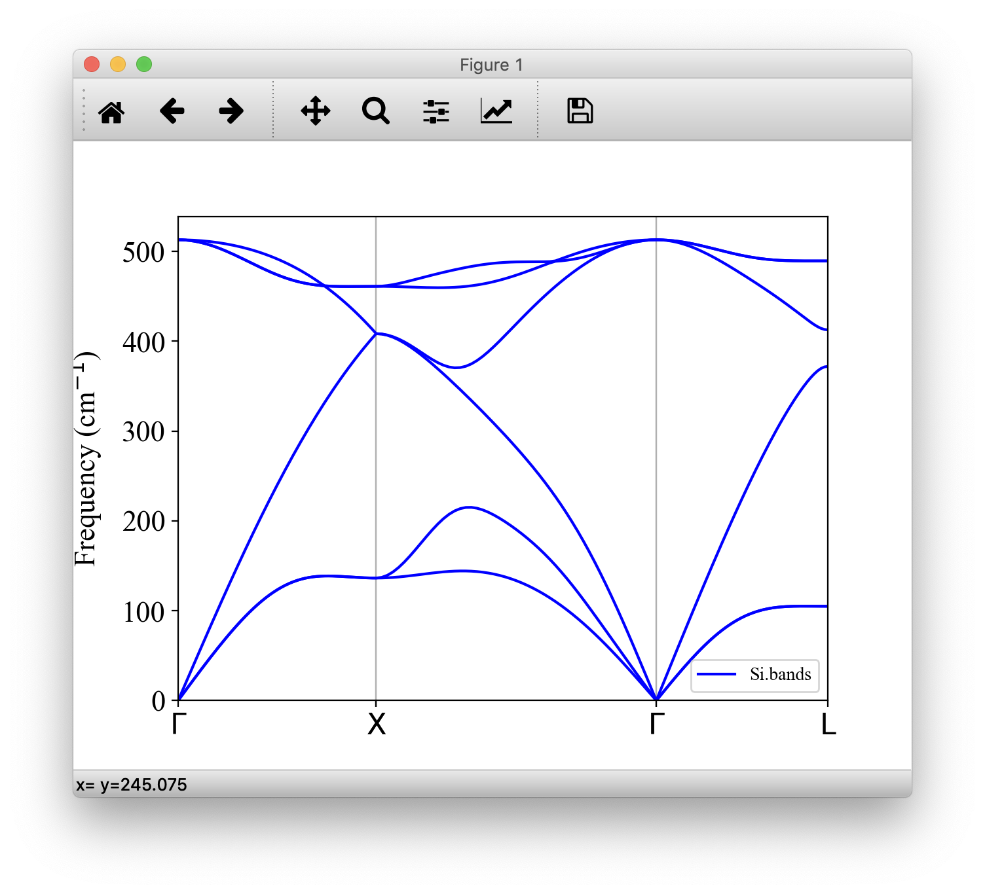
2.1 Calculate phonon dispersion curves
> cd ../../02_thermal_conductivity_silicon/work/ > cp ../../01_force_constant_silicon/work/si222_cubic.xml .
←(Create phband.in) > anphon phband.in > phband.log
> python3 -m plotband Si.bands
File: phband.in
&general
PREFIX = Si
MODE = phonons
NKD = 1; KD = Si
FCSXML = si222_cubic.xml
/
&cell
10.21
0.0 0.5 0.5
0.5 0.0 0.5
0.5 0.5 0.0
/
&kpoint
1
G 0.0 0.0 0.0 X 0.5 0.5 0.0 51
X 0.5 0.5 1.0 G 0.0 0.0 0.0 51
G 0.0 0.0 0.0 L 0.5 0.5 0.5 51
/
Important
Primitive lattice vectors must be given in the &cell field.
Tips
The k-point path is given in the fractional coordinate of the primitive reciprocal lattice vector
Useful tool: Seek-path https://www.materialscloud.org/work/tools/seekpath/

Slide 42
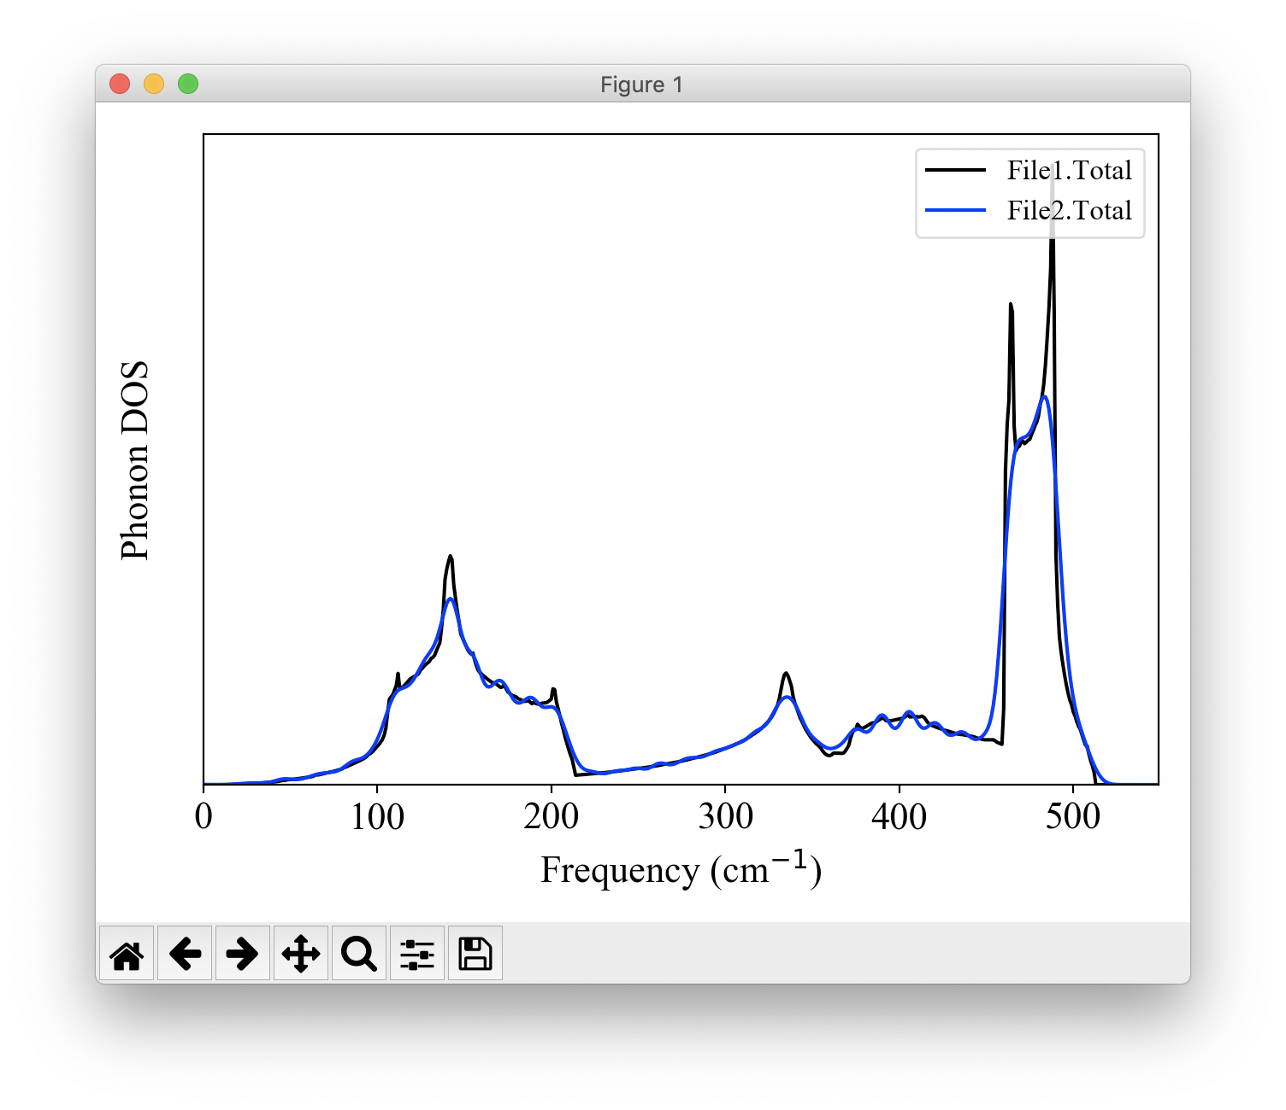
2.2 Calculate phonon DOS
File: phdos.in
&general
PREFIX = Si # use “Si2” for ISMEAR=1
MODE = phonons; NKD = 1; KD = Si
FCSXML = si222_cubic.xml
EMIN = 0; EMAX = 550; DELTA_E = 1
# Tetrahedron
ISMEAR = -1
# Gaussian broadening
#ISMEAR = 1; EPSILON = 7.0
/
&cell
10.21
0.0 0.5 0.5
0.5 0.0 0.5
0.5 0.5 0.0
/
&kpoint
2
20 20 20
/
> cp phband.in phdos.in (Edit phdos.in) > anphon phdos.in > phdos.log
> python -m plotdos Si.dos Si2.dos
Tetrahedron (ISMEAR=-1) v.s. Gaussian broadening (ISMEAR=1)

Slide 43
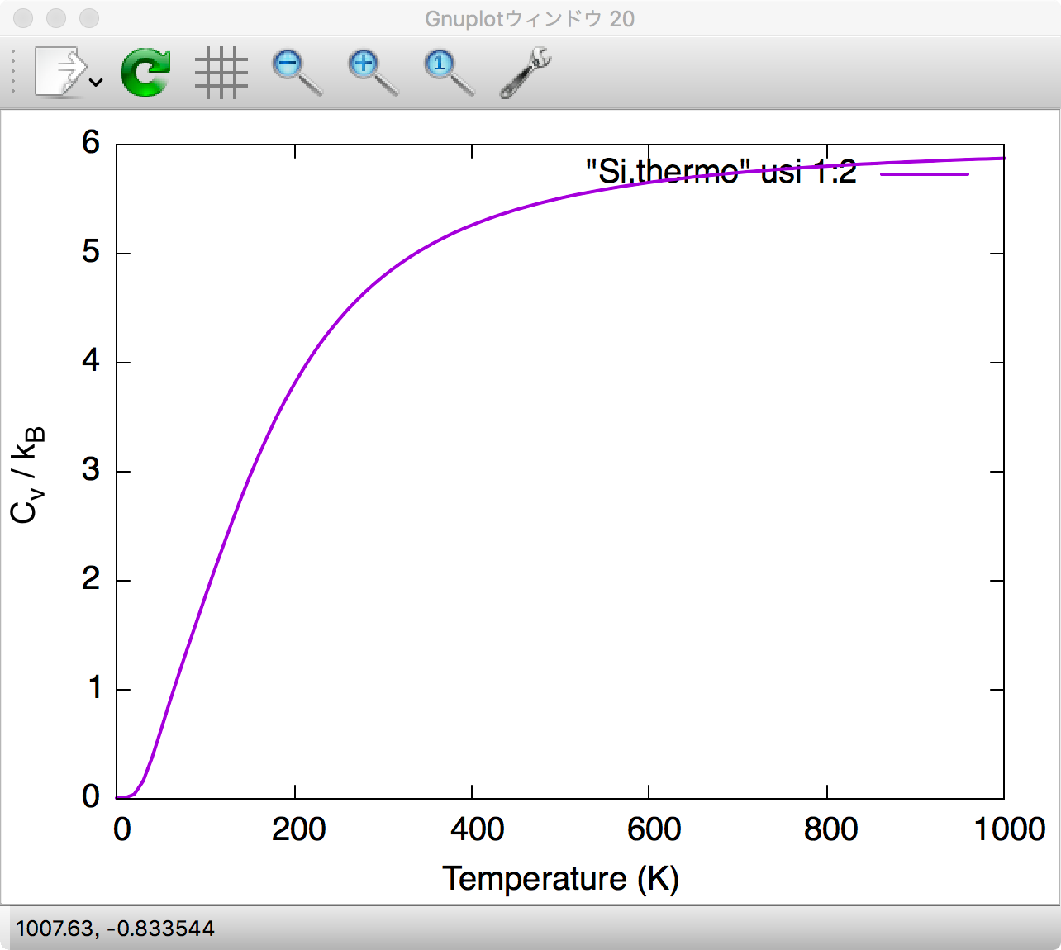
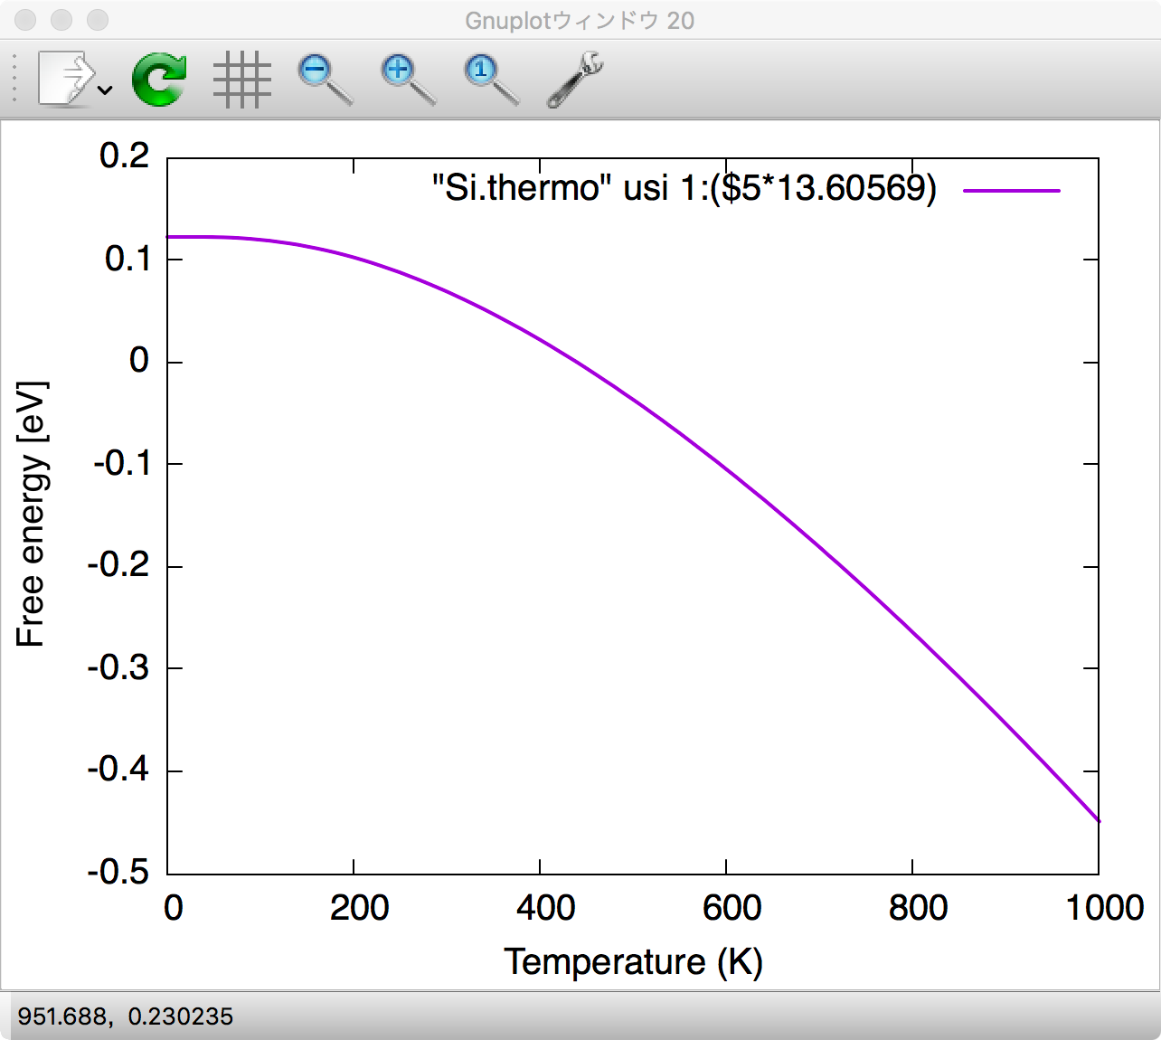
2.3 Thermodynamics functions
> less Si.thermo # Temperature [K], Heat capacity / kB, Entropy / kB, Internal energy [Ry], Free energy (QHA) [Ry]
0.000000 0.000000e+00 -0.000000e+00 9.000983e-03 9.000983e-03
10.000000 2.505659e-03 6.437732e-04 9.001016e-03 9.000976e-03
20.000000 3.315056e-02 8.601184e-03 9.001845e-03 9.000755e-03
30.000000 1.547310e-01 4.127771e-02 9.007206e-03 8.999362e-03
40.000000 3.696073e-01 1.136006e-01 9.023455e-03 8.994675e-03
50.000000 6.243941e-01 2.231466e-01 9.054848e-03 8.984182e-03
... > gnuplot gnuplot> set terminal qt font “Helvetica,20” gnuplot> set xlabel “Temperature (K)”
gnuplot> set ylabel “C_v/k_B”
gnuplot> plot “Si.thermo” usi 1:2 w l lw 2 gnuplot> set ylabel “Free energy [eV]”
gnuplot> plot “Si.thermo” usi 1:($5*﻿13.60569) w l lw 2

Slide 44
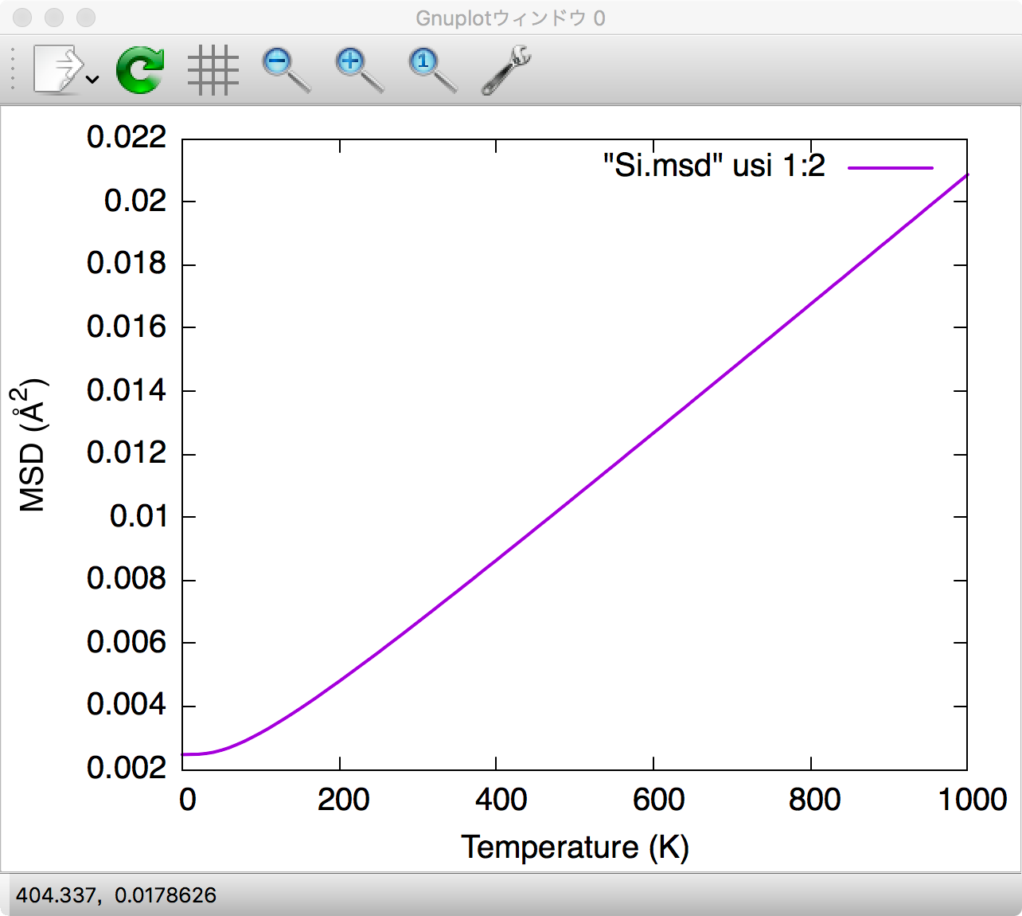
2.4 Mean square displacements
File: phdos.in
&analysis
PRINTMSD = 1 DOS = 0
/
> (Add the &analysis option) > anphon phdos.in > phdos.log
> less Si.msd # Mean Square Displacements at a function of temperature.
# Temperature [K], <(u_{1}^{x})^{2}>, <(u_{1}^{y})^{2}>, <(u_{1}^{z})^{2}>, .... [Angstrom^2]
0 0.00247213 0.00247213 0.00247213 0.00247213 0.00247213 0.00247213
10 0.00247304 0.00247304 0.00247304 0.00247304 0.00247304 0.00247304
20 0.00248178 0.00248178 0.00248178 0.00248178 0.00248178 0.00248178
30 0.0025045 0.0025045 0.0025045 0.0025045 0.0025045 0.0025045
... > gnuplot gnuplot> set terminal qt font “Helvetica,20” gnuplot> set xlabel “Temperature (K)”
gnuplot> set encoding iso
gnuplot> set ylabel “MSD (\305^{2})”
gnuplot> plot “Si.msd” usi 1:2 w l lw 2

Slide 45
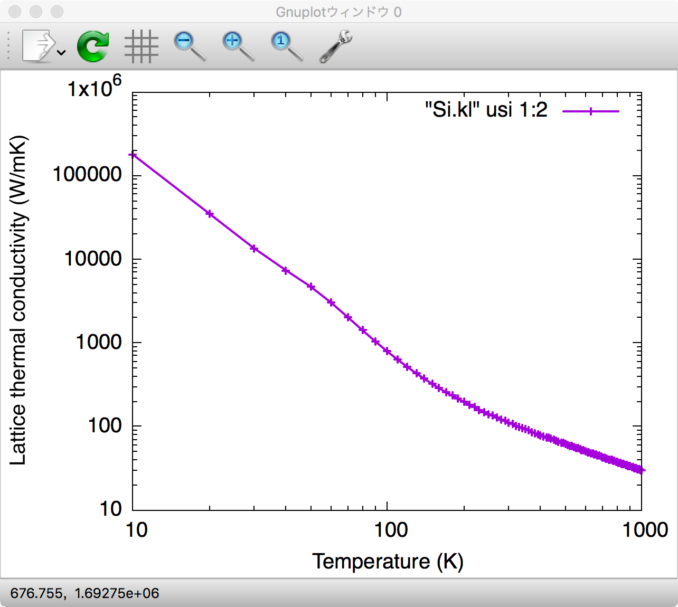
2.5 Lattice thermal conductivity (LTC)
File: RTA.in
BTE with the three-phonon scattering process only
&general
PREFIX = Si_q10
MODE = RTA NKD = 1; KD = Si
FCSXML = si222_cubic.xml
ISMEAR = -1
/
&cell
10.21
0.0 0.5 0.5
0.5 0.0 0.5
0.5 0.5 0.0
/
&kpoint
2
10 10 10
/
> cp phdos.in RTA.in ← (Edit RTA.in)
> anphon RTA.in > RTA_q10.log (This takes a while) > gnuplot gnuplot> set terminal qt font “Helvetica,20” gnuplot> set xlabel “Temperature (K)”
gnuplot> set ylabel “Lattice thermal conductivity (W/mK)”
gnuplot> set logscale xy
gnuplot> plot “Si.kl” usi 1:2 w lp lw 2
LTC diverges in the T→0 limit when only the three-phonon scattering is considered with ISMEAR=-1.

Slide 46
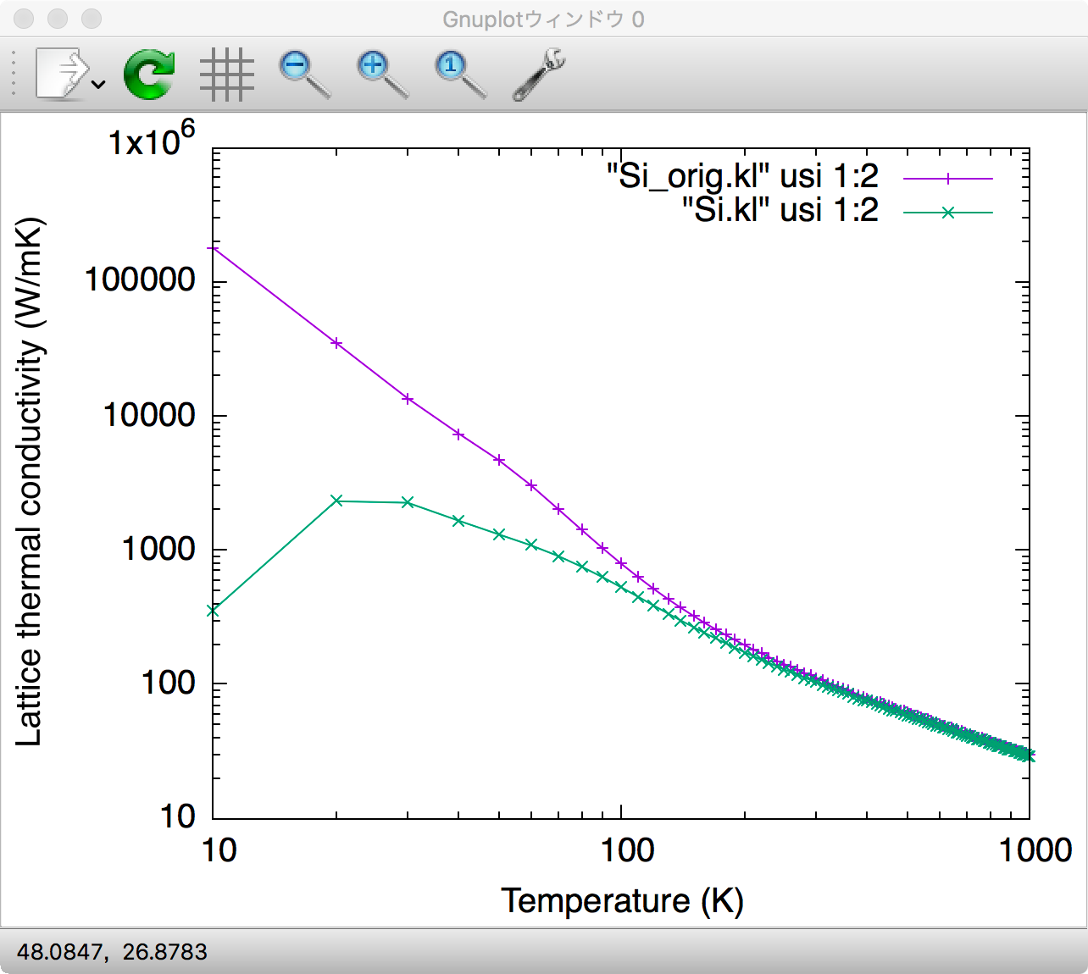
2.6 LTC with phonon-isotope scattering
Isotope impurities introduce the mass difference, which works as a scattering center of propagating phonons. The phonon self-energy associated with the phonon-isotope scattering can be calculated perturbatively as (PRB 27, 858 (1983))
File: RTA.in
&analysis
ISOTOPE = 2
/
> cp Si.kl Si_orig.kl ← (Add &analysis field in RTA.in)
> anphon RTA.in ... gnuplot> plot “Si_orig.kl” usi 1:2 w lp lw 2, “Si.kl” usi 1:2 w lp lw 2
is calculated automatically with the natural isotopic abundance.
Tips
When PREFIX.result exists in the working directory, the code restarts the RTA calculation and overwrites PREFIX.kl in the final step.

Slide 47
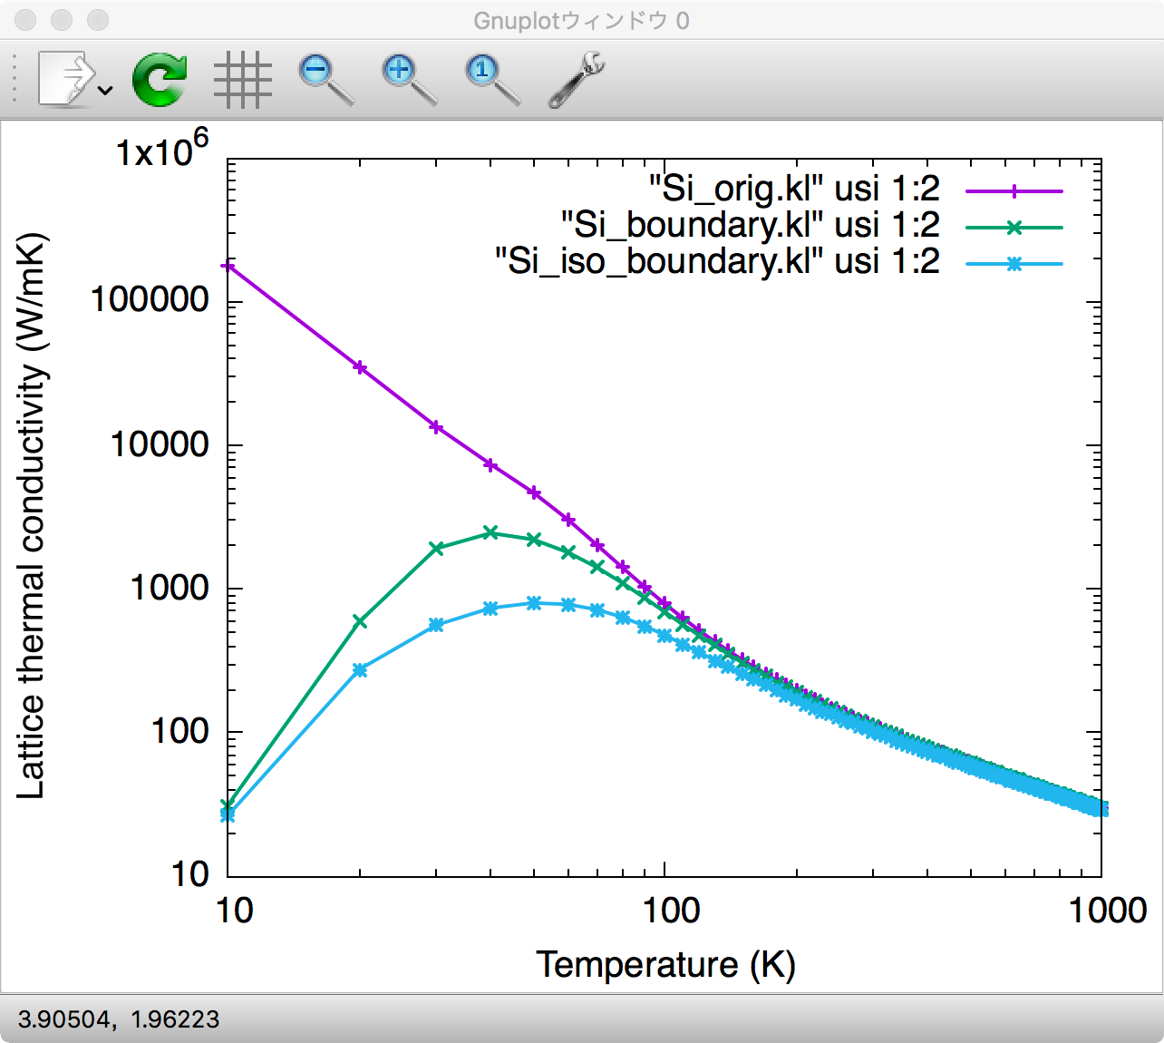
2.7 LTC with phonon-boundary scattering
Treatment of phonon-boundary scattering is difficult and not unique. In ALAMODE, we use the following equation (L is the grain size):
> python -m analyze_phonons --calc kappa_boundary --size 1.0e+5 Si.result > Si_boundary.kl
L in units of nm
> python -m analyze_phonons --calc kappa_boundary --isotope Si.self_isotpe --size 1.0e+5 Si.result > Si_iso_boundary.kl
Tips
The grain size L is somewhat arbitrary and usually set to reproduce the crystalline peak of LTC observed experimentally.

Slide 48
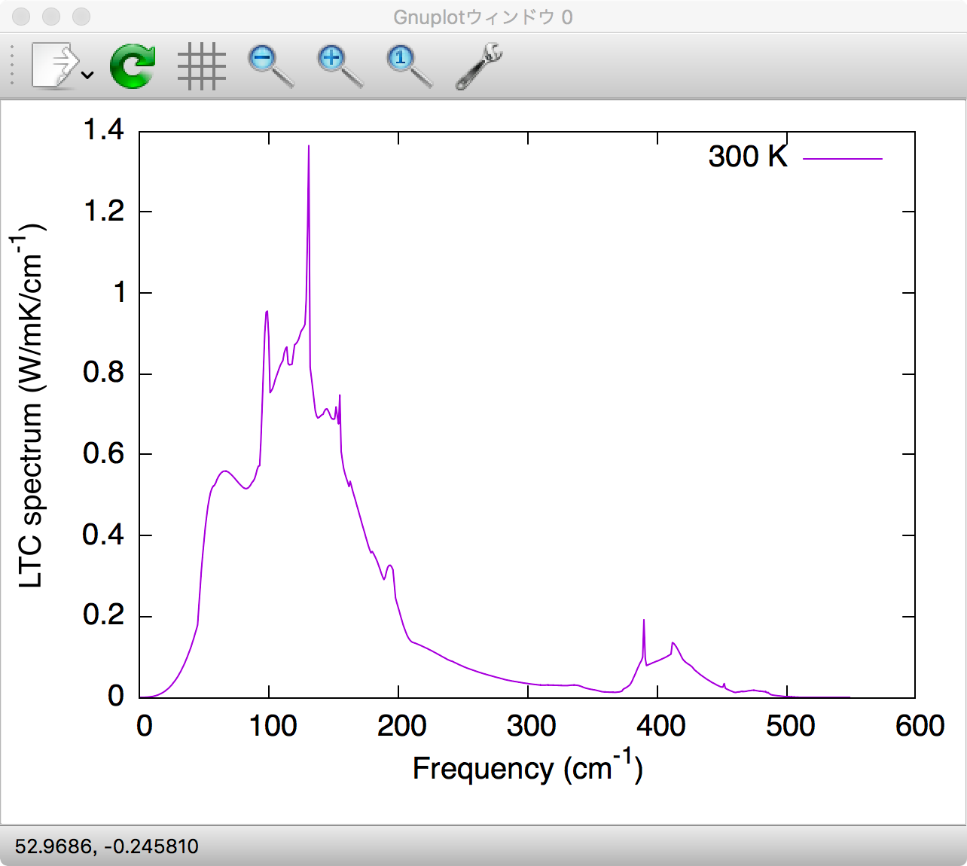
2.8 Lattice thermal conductivity spectrum
File: RTA.in
&general
PREFIX = Si_q10
MODE = RTA NKD = 1; KD = Si
FCSXML = si222_cubic.xml
ISMEAR = -1
EMIN = 0; EMAX = 550; DELTA_E = 1
/
...
&analysis
KAPPA_SPEC = 1
#ISOTOPE = 2
/
←(Edit RTA.in) > anphon RTA.in > gnuplot gnuplot> set terminal qt font “Helvetica,20” gnuplot> set xlabel "Frequency (cm^{-1})"
gnuplot> set ylabel "LTC spectrum (W/mK/cm^{-1})"
gnuplot> plot "< awk '{if ($1==300.0) print $0}' Si.kl_spec" usi 2:3 w l ti "300 K"
Most of the contribution to the total LTC comes from the low-frequency region below 200 cm⁻¹.

Slide 49
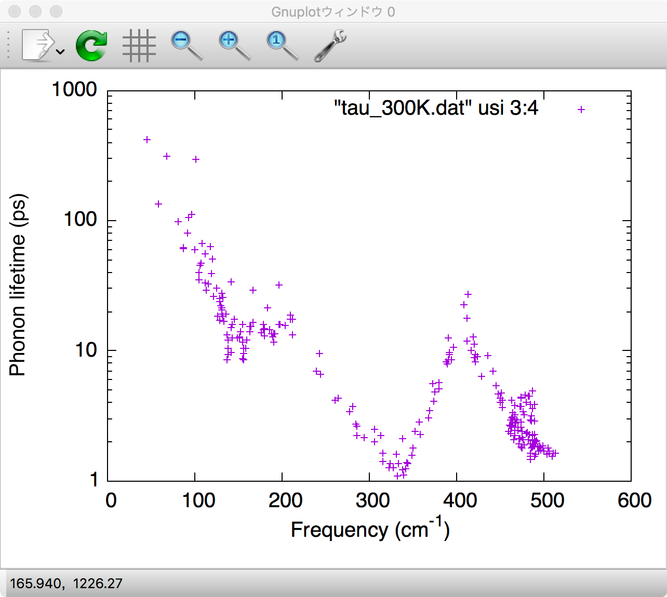
2.9 Phonon lifetime & mean-free-path
> python -m analyze_phonons --calc tau --temp 300 Si.result > tau_300K.dat > less -S tau_300K.dat # Result analyzer ver. 1.0.5
# Input file : Si.result
# Phonon lifetime at temperature 300 K.
# kpoint range 1 47
# mode range 1 6
# ik, is, Frequency [cm^{-1}], Lifetime [ps], |Velocity| [m/s], MFP [nm], Multiplicity, Thermal conductivity par mode (xx, xy, ...) [W/mK]
1 1 1.09737e-10 0 0 0 1 0 0 0 0
1 2 1.09737e-10 0 0 0 1 0 0 0 0
1 3 1.09737e-10 0 0 0 1 0 0 0 0
1 4 512.879 1.64158 0 0 1 0 0 0 0
1 5 512.879 1.64158 0 0 1 0 0 0 0
1 6 512.879 1.64158 0 0 1 0 0 0 0
2 1 45.1491 415.681 3913.62 1626.82 8 0.739933 2.54542e-07 2.54542e-07 2.54542e-07
2 2 45.1491 415.681 3913.62 1626.82 8 0.740513 2.52624e-07 2.52624e-07 2.52624e-07
2 3 93.2234 104.718 8599.52 900.527 8 0.888976 9.01551e-13 9.01551e-13 9.01551e-13
...
> gnuplot
gnuplot> set xlabel “Frequency (cm^{-1})”
gnuplot> set ylabel “Lifetime (ps)”
gnuplot> set logscale y gnuplot> plot “tau_300K.dat” usi 3:4 w p gnuplot> set ylabel “MFP (nm)” gnuplot> plot “tau_300K.dat” usi 3:6 w p

Slide 50
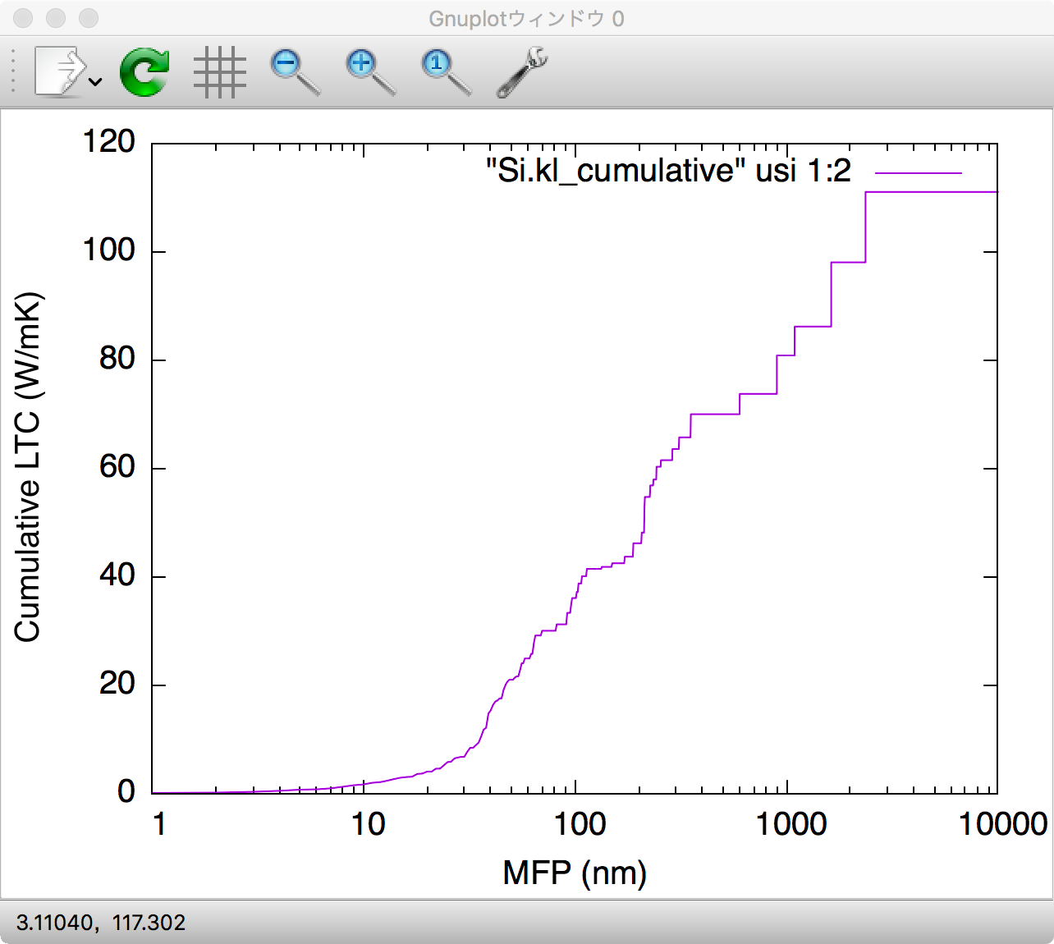
2.10 Cumulative thermal conductivity
: Heaviside step function
phonon MFP
> python -m analyze_phonons --calc cumulative --temp 300 --length 10000:1 Si.result > Si.kl_cumulative
(Max. of L):(Length step dL) in units of nm
> gnuplot gnuplot> set terminal qt font “Helvetica,20” gnuplot> set xlabel ”MFP (nm)”
gnuplot> set ylabel ”Cumulative LTC(W/mK)"
gnuplot> set logscale x
gnuplot> plot “Si.kl_cumulative” usi 1:2 w l

Slide 51
2.11 Convergence check
The calculated LTC gradually increases with increasing the q-point mesh density and eventually reaches convergence.
Optional task:
File: RTA.in
&general
PREFIX = Si_q15
MODE = RTA NKD = 1; KD = Si
FCSXML = si222_cubic.xml
ISMEAR = -1
/
...
&kpoint
2
15 15 15
/
Perform the calculation again with a denser q-point grid and check how the result changes
Tips
The computational cost increases in proportion to where N_{p} is the number of atoms in the primitive cell and N_{k} is the number of q points.
RTA tends to underestimate LTC of silicon and other high-LTC materials. To achieve a perfect agreement with the experimental value, a full solution to BTE is necessary (which is not supported in ALAMODE).

Slide 52
2.12 Summary of part 2
Harmonic phonon properties (dispersion, DOS, thermodynamic functions, mean-square displacement)
Lattice thermal conductivity with three-phonon, ph-isotope, and ph-boundary scatterings.
Various spectral decomposition of thermal conductivity

Slide 53
Hands-on: part 3
Topics
Phonon calculation of cubic SrTiO₃ (harmonic level)
Self-consistent phonon calculation of cubic SrTiO₃

Slide 54
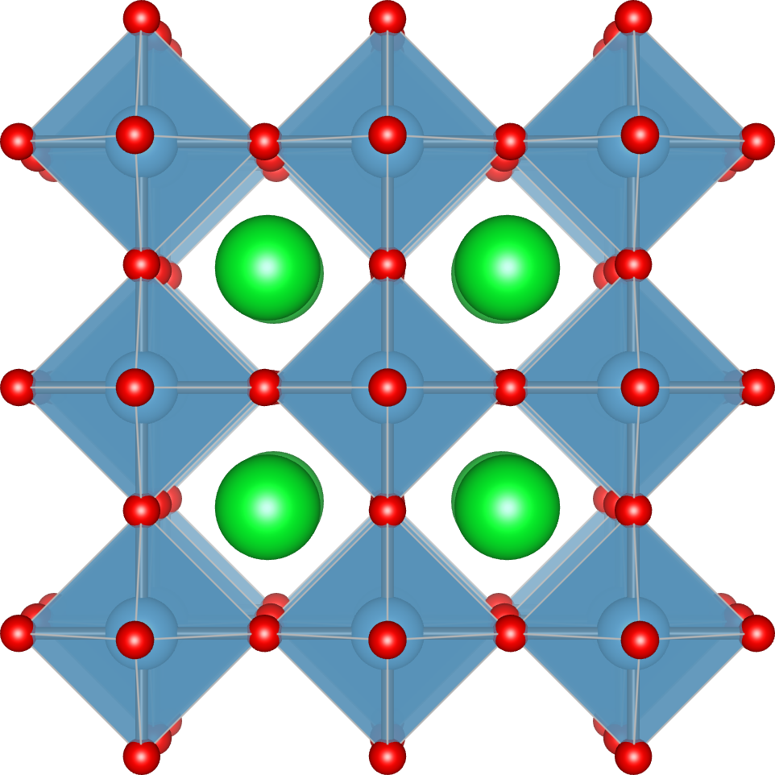
3.0 Details of the provided data
This part requires quartic IFCs of cubic SrTiO₃, whose calculation is computationally demanding. So, we provide the STO_tadano.xml which contains harmonic/anharmonic IFCs necessary to run the self-consistent phonon.
Computational details
Original paper: T. Tadano and S. Tsuneyuki, Phys. Rev. B 92, 054301 (2015); J. Phys. Soc. Jpn. 87, 041015 (2018).
VASP, PBEsol, ENCUT= 550 eV
2x2x2 supercell (40 atoms)
Anharmonic IFCs are estimated by the compressive sensing lattice dynamics (LMODEL = enet)

Slide 55
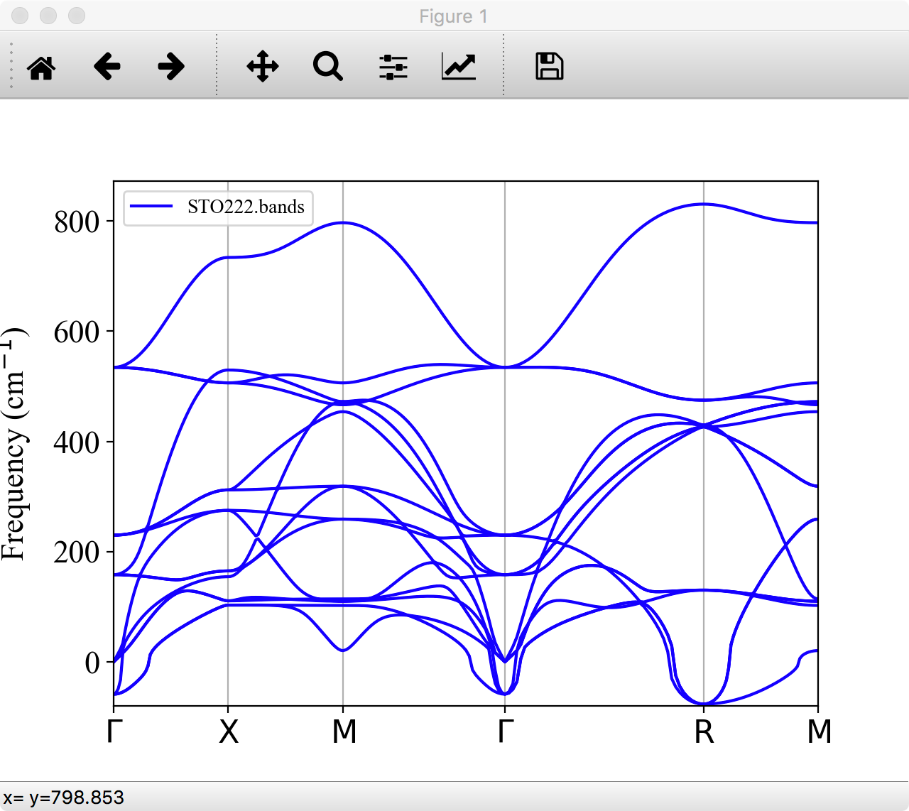
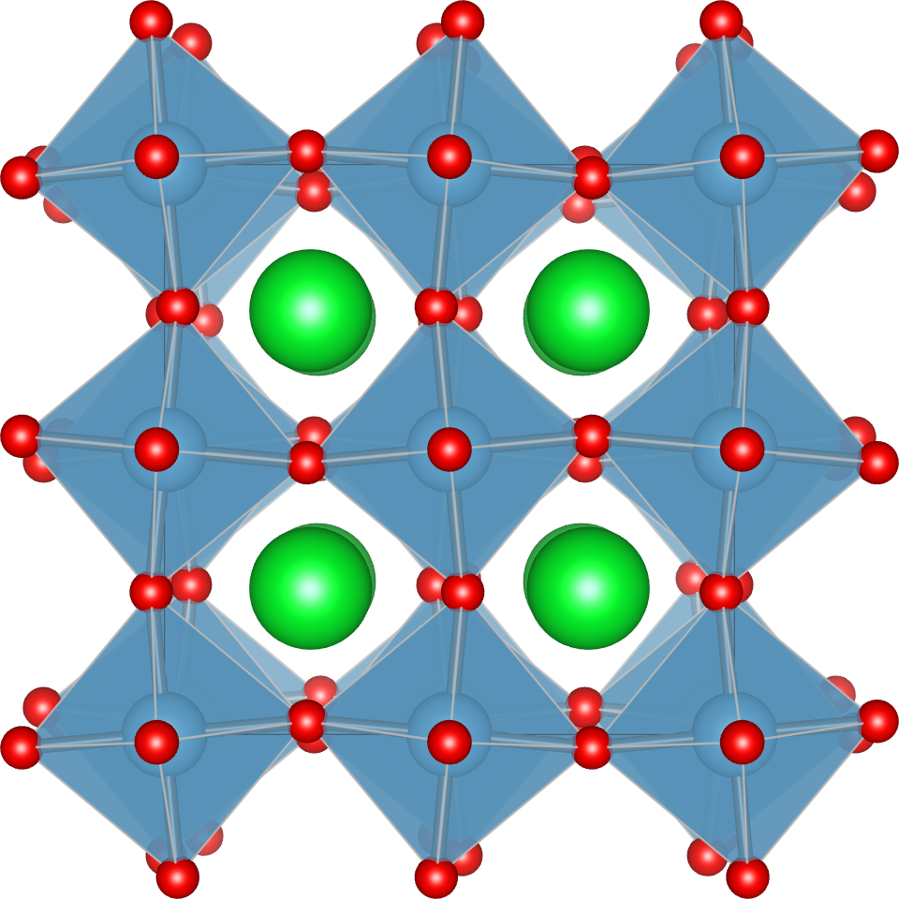
3.1 Harmonic IFCs & harmonic phonons
> cd ../../03_self_consistent_phonon_STO/work/
> cp ../ref/ALM1.in .
> less ALM1.in &general
PREFIX = STO222
MODE = opt
NAT = 40; NKD = 3
KD = Sr Ti O
/
&interaction
NORDER = 1
/
&cutoff
*-* None
/
&optimize
DFSET = ../data/DFSET_harmonic
/
...
> alm ALM1.in > ALM1.log > grep “Fitting error” ALM1.log Fitting error (%) : 1.53358
> cp ../ref/phband.in .
> anphon phband.in > phband.log
> python3 -m plotband STO222.bands
Cubic
Antiferrodistortive (AFD) soft mode
Tetragonal

Slide 56
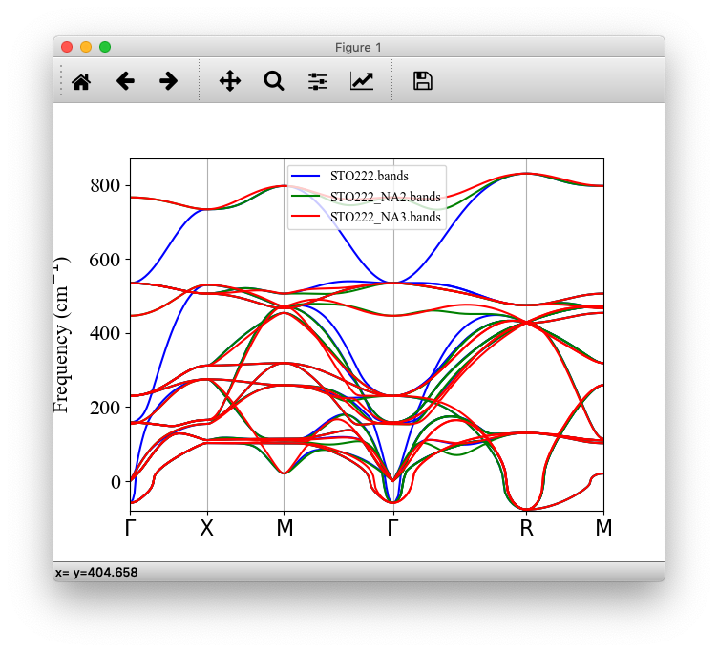
3.2 LO-TO splitting
File: phband.in
File: STO.Born
Important
&general
PREFIX = STO222_NA2
MODE = phonons NKD = 3; KD = Sr Ti O
FCSXML = STO222.xml
NONANALYTIC = 2
BORNINFO = STO.born
/
...
6.350838 -0.000000 -0.000000
0.000000 6.350838 -0.000000
0.000000 0.000000 6.350838
2.55161 0.00000 -0.00000
-0.00000 2.55161 0.00000
-0.00000 0.00000 2.55161
7.34739 0.00000 0.00000
0.00000 7.34739 -0.00000
0.00000 0.00000 7.34739
-5.82005 0.00000 0.00000
0.00000 -2.04025 -0.00000
-0.00000 -0.00000 -2.04025
-2.04025 -0.00000 -0.00000
-0.00000 -5.82004 0.00000
0.00000 0.00000 -2.04025
-2.04025 0.00000 0.00000
0.00000 -2.04025 0.00000
0.00000 -0.00000 -5.82005
The order of Born effective charges in BORNINFO file must corresponds to the order in phband.log:
Atomic positions in the primitive cell (fractional):
1: 0.000000e+00 0.000000e+00 0.000000e+00 Sr
2: 5.000000e-01 5.000000e-01 5.000000e-01 Ti
3: 0.000000e+00 5.000000e-01 5.000000e-01 O
4: 5.000000e-01 0.000000e+00 5.000000e-01 O
5: 5.000000e-01 5.000000e-01 0.000000e+00 O
(obtained by DFPT)
> cp ../ref/STO.Born
> anphon phband.in > phband.log
> python3 -m plotband STO222.bands STO222_NA2.bands

Slide 57
3.3 Anharmonic IFCs
Anharmonic force constants up to sixth-order were calculated by applying the compressive sensing approach to the training datasets generated with AIMD + random displacements.
Solution of the compressive sensing takes ~30 mins., so we skip this part today. Please copy the XML file in the ref/ directory:
> cp ../ref/STO_tadano.xml .

Slide 58
3.4 Self-consistent phonon (SCPH) calculation
File: scph.in
&general
PREFIX = STO_scph2-2
MODE = SCPH NKD = 3; KD = Sr Ti O
FCSXML = STO_tadano.xml
NONANALYTIC = 2
BORNINFO = STO.born
TMIN = 0; TMAX = 1000
DT = 50
/
&scph
SELF_OFFDIAG = 0
MAXITER = 500
MIXALPHA = 0.2
KMESH_INTERPOLATE = 2 2 2
KMESH_SCPH = 2 2 2
/
…
SCPH loop (SELF_OFFDIAG = 0):
Step 1. Calculate harmonic dynamical matrix and its eigenvalues and eigenvectors →
Step 2. Compute the fourth-order coupling coefficients in the basis of harmonic eigenvectors
Step 3. Continue the following iteration until new phonon frequencies are converged
Temperature dependent term

Slide 59
3.5 Run SCPH calculation
> anphon scph.in > scph.log (This takes about 5-10 minutes.) > grep “conv” scph.log
Temp = 1.000000e+03 : convergence achieved in 58 iterations.
Temp = 9.500000e+02 : convergence achieved in 30 iterations.
Temp = 9.000000e+02 : convergence achieved in 30 iterations.
Temp = 8.500000e+02 : convergence achieved in 30 iterations.
Temp = 8.000000e+02 : convergence achieved in 30 iterations.
Temp = 7.500000e+02 : convergence achieved in 30 iterations.
Temp = 7.000000e+02 : convergence achieved in 31 iterations.
Temp = 6.500000e+02 : convergence achieved in 31 iterations.
Temp = 6.000000e+02 : convergence achieved in 31 iterations.
Temp = 5.500000e+02 : convergence achieved in 31 iterations.
Temp = 5.000000e+02 : convergence achieved in 31 iterations.
Temp = 4.500000e+02 : convergence achieved in 31 iterations.
Temp = 4.000000e+02 : convergence achieved in 32 iterations.
Temp = 3.500000e+02 : convergence achieved in 32 iterations.
Temp = 3.000000e+02 : convergence achieved in 32 iterations.
Temp = 2.500000e+02 : convergence achieved in 33 iterations.
Temp = 2.000000e+02 : convergence achieved in 33 iterations.
Temp = 1.500000e+02 : convergence achieved in 34 iterations.
Temp = 1.000000e+02 : convergence achieved in 44 iterations.
Temp = 5.000000e+01 : convergence achieved in 64 iterations.
Temp = 0.000000e+00 : not converged.
The self-consistent loop stops when the change of the phonon frequencies becomes smaller than TOL_SCPH and the resulting dynamical matrix is positive semi-definite.
In the low temperature region, the self-consistent loop (of the current algorithm) becomes unstable due to a smaller MSD factor.
Tips
Decreasing MIXALPHA and/or DT can improve the convergence in the low-T region

Slide 60
3.6 Output files of SCPH calculation
> ls -1tr STO_scph2-2.* STO_scph2-2.scph_dymat
STO_scph2-2.scph_dfc2
STO_scph2-2.scph_bands
PREFIX.scph_dfc2
Anharmonic correction to the second-order IFCs
PREFIX.scph_dymat
Anharmonic correction to the dynamical matrix
is saved where and M is the diagonal matrix whose elements are atomic masses.
is saved for the given q and temperature grid.
Note
Note
PREFIX.scph_dfc2 is used to create effective second-order IFCs
When PREFIX.scph_dymat exists in the working directory, the code loads ΔD(q,T) from the file instead of running a SCPH calculation from scratch.
Use dfc2 for ALAMODE XML format
Use scph_to_qefc.py for QE fc format

Slide 61
3.7 Important notes on SCPH
The q points sampled by KMESH_INTERPOLATE should be commensurate with the supercell size (of harmonic IFCs).
KMESH_SCPH must be an integral multiple of KMESH_INTERPOLATE e.g. When KMESH_INTERPOLATE = 2 2 2, KMESH_SCPH must be KMESH_SCPH = 2 2 2, 4 4 4, 6 6 6, etc.
Do not use an anisotropic q gird for isotropic systems.
Anharmonic corrections are saved in the files even when the convergence is not achieved. Do not use the unconverged results as they are not reliable.
Currently, the SCPH iteration does not support NONANALYTIC=3. Please use NONANALYTIC=2 instead. After the SCPH calculation finishes, you can switch to NONANALYTIC=3 in the restart mode.

Slide 62
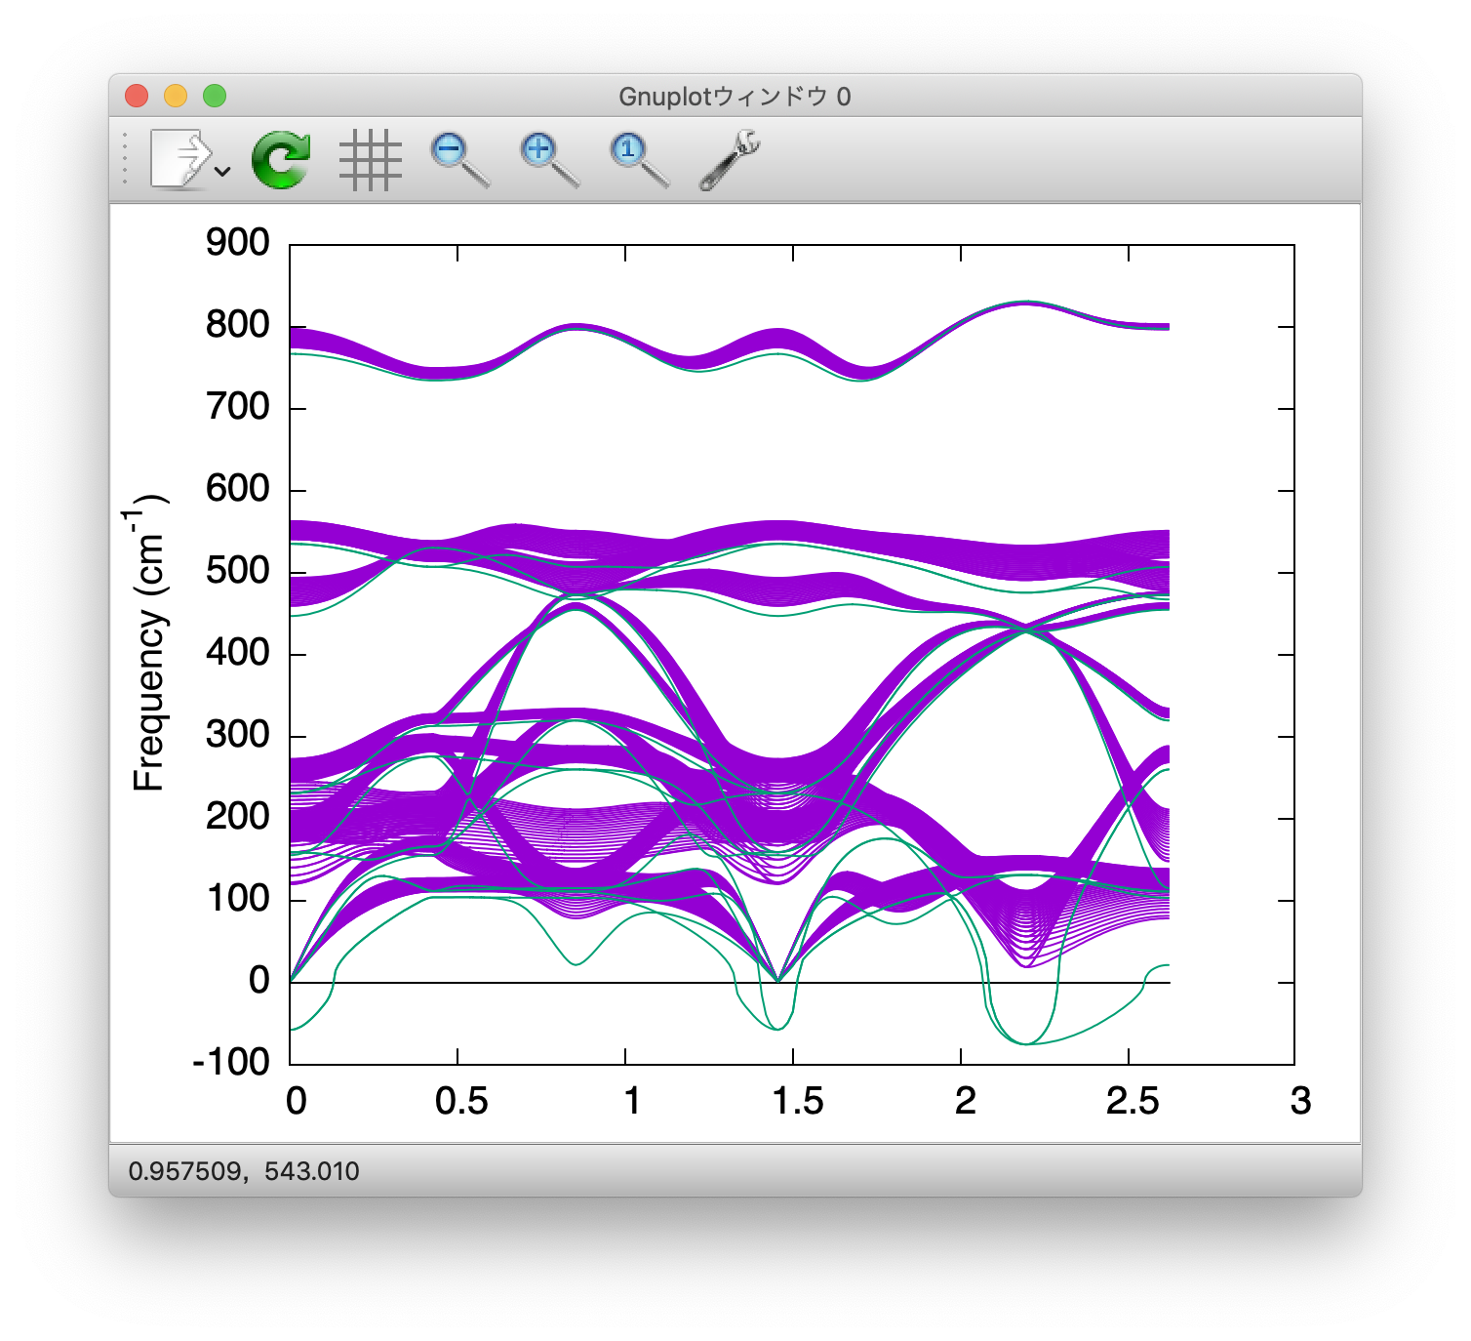
3.8 Visualize finite-T phonon dispersion
> gnuplot gnuplot> set terminal qt font “Helvetica,20” gnuplot> set ylabel “Frequency (cm^{-1})”
gnuplot> unset key
gnuplot> plot for [col=3:17] “STO_scph2-2.scph_bands” usi 2:col w l lt 1
gnuplot> replot for [col=2:16] “STO222_NA2.bands” usi 1:col w l lt 2

Slide 63
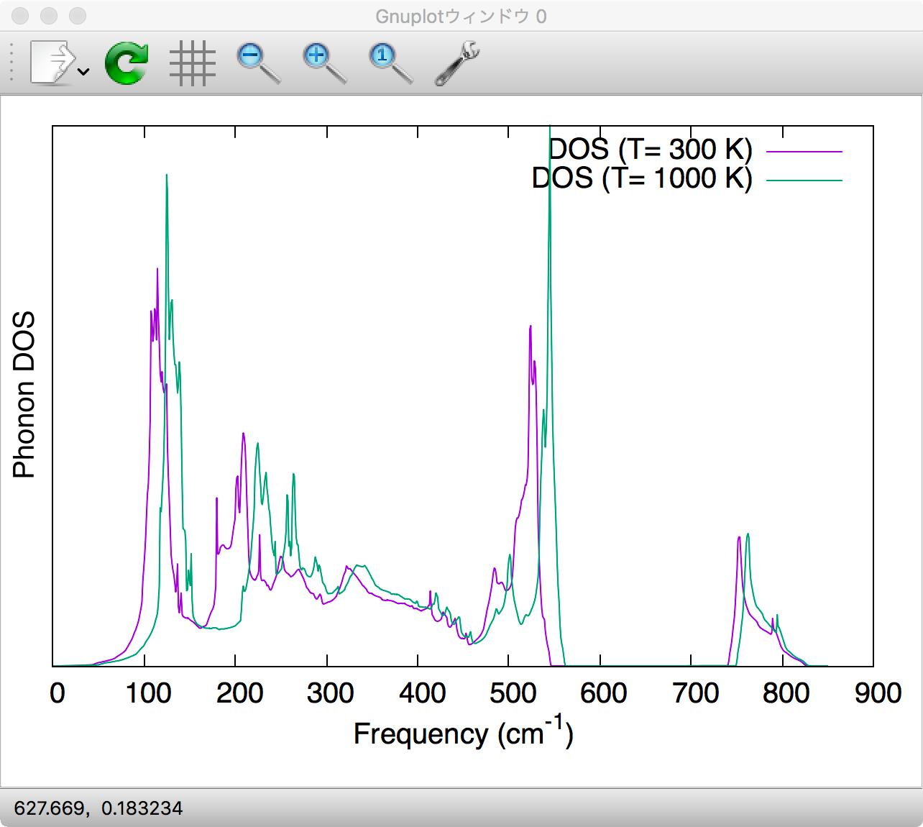
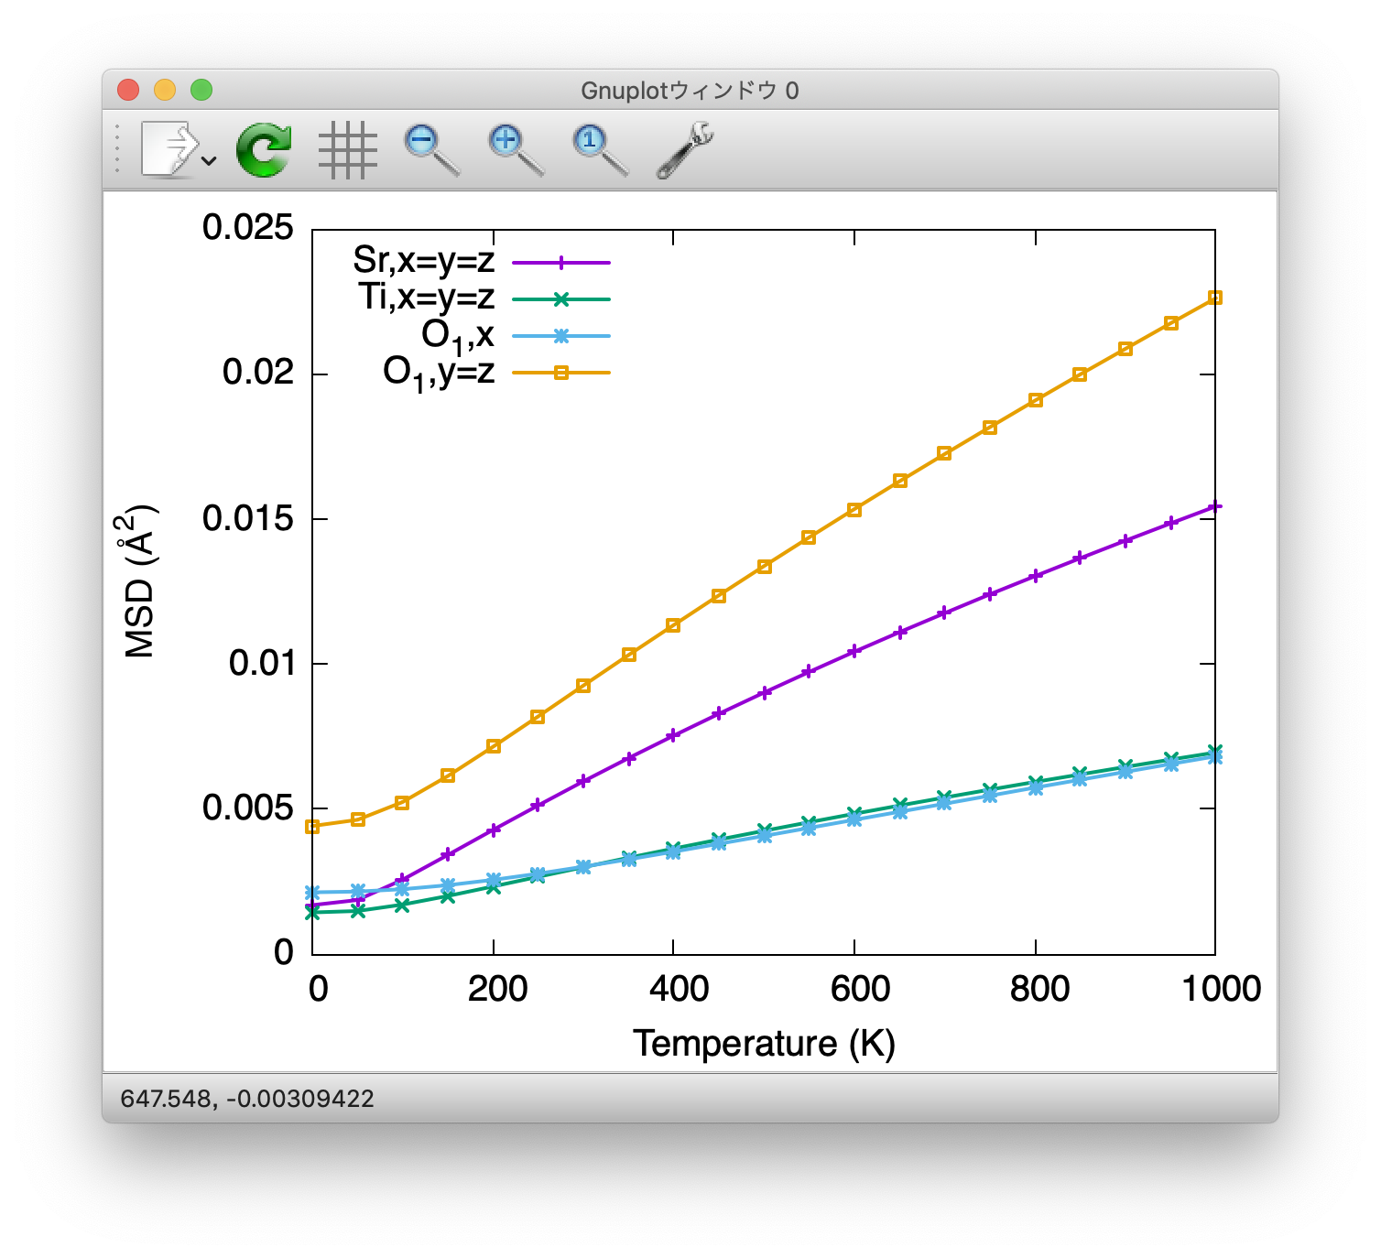
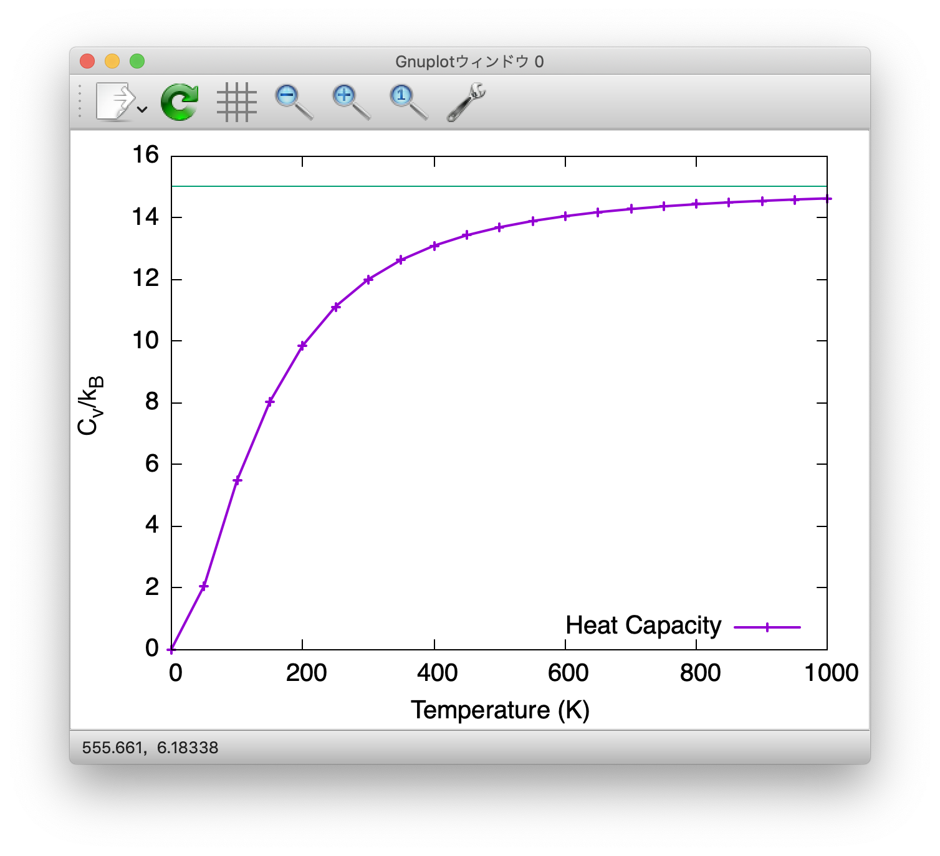
3.9 Finite-T phonon DOS & thermodynamic function
File: scph.in
STO_scph2-2.scph_dos
&general
PREFIX = STO_scph2-2
MODE = SCPH NKD = 3; KD = Sr Ti O
FCSXML = STO_tadano.xml
EMIN = -100; EMAX = 850; DELTA_E = 1.0
TMIN = 0; TMAX = 1000;
DT = 50
/
&kpoint
2
10 10 10
/
&analysis
PRINTMSD = 1
/
← (Edit scph.in)
> anphon scph.in (This takes ~5 mins.)
> ls -1 STO_scph2-2.* STO_scph2-2.scph_dos
STO_scph2-2.scph_msd
STO_scph2-2.scph_thermo
...
STO_scph2-2.scph_msd
STO_scph2-2.scph_thermo

Slide 64
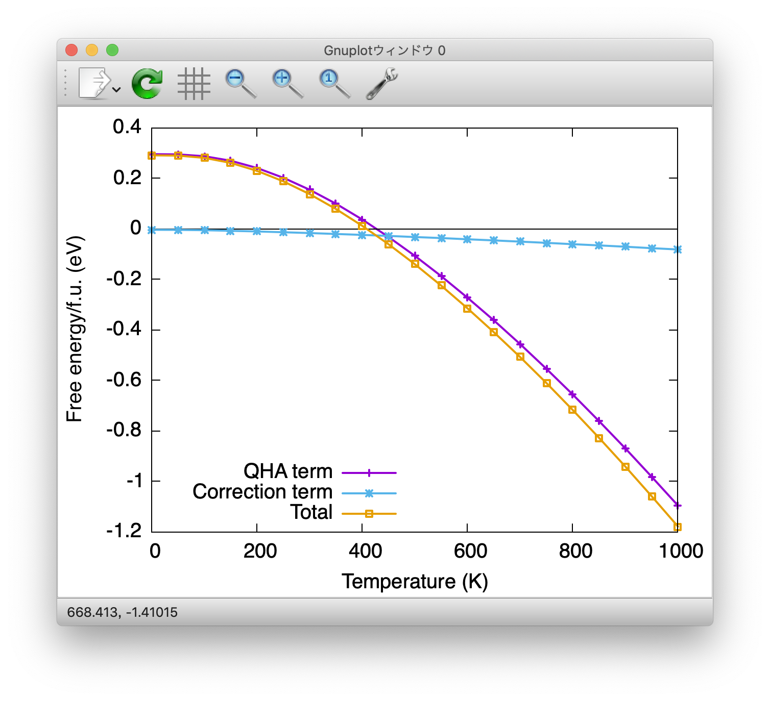
3.10 Vibrational free-energy with anharmonic effects
> less -S STO_scph2-2.scph_thermo # Temperature [K], Cv [in kB unit], F_{vib} (QHA term) [Ry], F_{vib} (SCPH correction) [Ry]
0.000000 0.000000e+00 2.167446e-02 -3.378847e-04 # This line is not reliable
50.000000 2.062933e+00 2.162180e-02 -3.577302e-04
100.000000 5.472727e+00 2.108655e-02 -4.657560e-04
150.000000 8.029008e+00 1.976537e-02 -6.273659e-04
200.000000 9.847678e+00 1.765686e-02 -8.229919e-04
250.000000 1.111219e+01 1.482308e-02 -1.044827e-03
300.000000 1.199630e+01 1.133614e-02 -1.288477e-03
QHA term
Correction term

Slide 65
3.11 Classical limit (optional)
File: scph.in
&general
PREFIX = STO_scph2-2_CL
MODE = SCPH NKD = 3; KD = Sr Ti O
FCSXML = STO222.xml
EMIN = -100; EMAX = 850; DELTA_E = 1.0
TMIN = 0; TMAX = 1000;
DT = 50
CLASSICAL = 1
/
&kpoint
...
/
By setting CLASSICAL=1, the code uses classical statistics instead of the quantum version.
This flag affects SCPH results, thermodynamic functions, and lattice thermal conductivity.
Optional task:
Run the SCPH calculation again with CLASSICAL=1 and check how the results change.

Slide 66
3.12 Summary of part 3
Harmonic and self-consistent phonon calculations of cubic SrTiO3.
Unstable soft modes can be stabilized by quartic anharmonicity at finite temperatures.
Anharmonic vibrational free energy

Slide 67
Summary
Fundamental theory of phonon anharmonicity
Three major features of ALAMODE: force constant estimation (ALM), lattice thermal conductivity calculation, and self-consistent phonon calculation (ANPHON)
Many functionalities not covered today: see the documentation page for details
ALM python API is under development: visit https://github.com/ttadano/ALM
If you have a question, please email me (or create an issue on GitHub repository).
Your contribution to the phonon calculation community and ALAMODE code is very welcome.

Slide 68
Compressive sensing
Elastic-net
LASSO
Ridge regression
is a hyperparameter that controls the trade-off between the sparsity and accuracy of the model. An optimal value of can be estimated by cross validation (CV).
See statistical learning textbooks for more details of CV and enet.
https://web.stanford.edu/~hastie/ElemStatLearn/

Slide 69
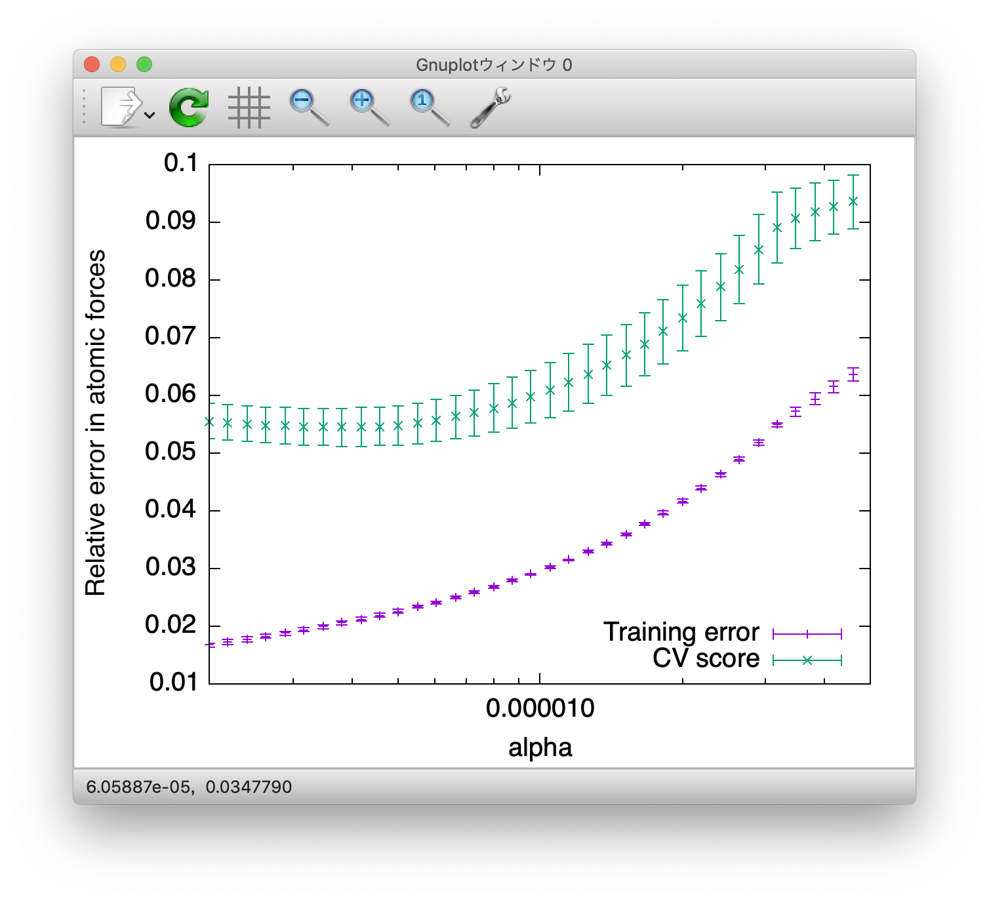
Cross-validation
File: CV.in
> alm CV.in > CV.log & (This takes ~20 mins.) > gnuplot gnuplot> set logscale x gnuplot> plot “STO_anharm.cvscore” usi 1:2:3 w yerr ti “Training error” gnuplot> replot “STO_anharm.cvscore” usi 1:4:5 w yerr ti “CV score”
&general
PREFIX = STO_anharm
MODE = optimize
NAT = 40; NKD = 3
KD = Sr Ti O
/
&interaction
NORDER = 5
NBODY = 2 3 3 2 2
/
&cutoff
*-* None None 12.0 12.0 12.0
/
&optimize
LMODEL = enet
NDATA = 40
DFSET = ../data/DFSET_AIMD+random
FC2XML = STO222.xml
CV = 4
L1_RATIO = 1.0 #LASSO
CV_MINALPHA = 2.0e-6
CV_MAXALPHA = 0.02
CV_NALPHA = 100
STANDARDIZE = 1
CONV_TOL = 1.0e-8
/
Anharmonic terms up to sixth-order
40 training datasets and 4-fold CV
3.81092e-06

Slide 70
Enet optimization
File: opt.in
> cp CV.in opt.in ← (Edit opt.in) > alm opt.in > opt.log > ls STO_tadano* STO_tadano.fcs STO_tadano.xml
> less STO_tadano.fcs 678 629 0.0000000e+00 2 17y 19y 23x 9.018
679 630 0.0000000e+00 2 17x 21z 22z 9.018
680 631 -2.4761761e-03 2 17x 18x 23x 7.363
681 632 -1.0026889e-04 2 17x 18y 23y 7.363
682 633 -1.0915336e-03 2 17x 18z 23x 7.363
683 634 2.1869848e-03 2 17x 18z 23z 7.363
684 635 -0.0000000e+00 2 17y 18y 23x 7.363
685 636 0.0000000e+00 2 17y 18z 23y 7.363
686 637 -3.6977389e-05 2 17y 19y 21x 7.363
687 638 0.0000000e+00 4 17x 18x 27x 9.018
688 639 0.0000000e+00 4 17x 18y 27y 9.018
689 640 1.5151960e-04 4 17x 18z 27x 9.018
690 641 0.0000000e+00 4 17x 18z 27z 9.018
&general
PREFIX = STO_tadano
MODE = optimize
NAT = 40; NKD = 3
KD = Sr Ti O
/
…
&optimize
LMODEL = enet
NDATA = 40
DFSET = ../data/DFSET_AIMD+random
FC2XML = STO222.xml
CV = 0 # switch off CV
L1_RATIO = 1.0 #LASSO L1_ALPHA = 3.81092e-06
CV_MINALPHA = 2.0e-6
CV_MAXALPHA = 0.02
CV_NALPHA = 100
STANDARDIZE = 1
CONV_TOL = 1.0e-9 # more strict tol (optional)
/
Many IFCs are exactly zero!

Slide 71
Polarization mixing in SCPH
The off-diagonal components of the loop diagram are considered by setting SELF_OFFDIAG = 1, which induces the polarization mixing (PM)
PM occurs between phonon modes belonging to the same irreducible representation.
PM is important in SrTiO₃ at high temperatures
SELF_OFFDIAG = 1 is more expensive than SELF_OFFDIAG = 0
Complexity
SELF_OFFDIAG = 0
SELF_OFFDIAG = 1
Phys. Rev. B 92, 054301 (2015)

Slide 72
Solve BTE on top of a SCPH solution
ALAMODE supports thermal conductivity calculations on top of the SCPH solution. The procedure is explained in the next slide.

Slide 73
Solve BTE on top of a SCPH solution
Calculate with dfc2
> dfc2 DFC2 -- a generator of renormalized harmonic FCs from SCPH outputs.
XML file containing original FC2 : STO222.xml
Output xml filename with anharmonic correction : STO222_SCPH2-2_300K.xml
FC2 correction file from SCPH calculation : STO_scph2-2.scph_dfc2
Target temperature : 300
New XML file STO222_SCPH2-2_300K.xml was created successfully.
&general
PREFIX = STO_SCPH300K; MODE = RTA NKD = 3; KD = Sr Ti O
FCSXML = STO_tadano.xml FC2XML = STO222_SCPH2-2_300K.xml
/
&kpoint
2
10 10 10
/
Use harmonic IFCs in FC2XML and cubic IFCs in FCSXML in thermal conductivity calculation
← (Edit RTA.in)
> anphon RTA.in > RTA.log > awk ‘{if ($1==300.0) print $0}’ STO_SCPH300K.kl 300.00 9.7397 0.0003 0.0003 …
File: RTA.in

Slide 74
Use effective second-order IFCs in Quantum ESPRESSO
pw.x
> python -m scph_to_qe2 original.fc PREFIX.scph_dfc2 300 > new.fc
ph.x
q2r.x
matdyn.x
lambda.x

